Slide 1
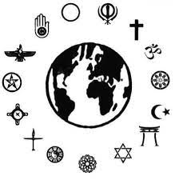
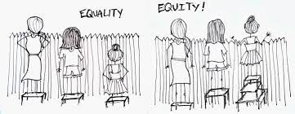
Year 7 RE Knowledge Organiser
Key Concepts
Tolerance | Acceptance of people with differences to ourselves
Prejudice | Making your mind up before you know (‘pre judging’) ‘Judging a book by it’s cover’
Discrimination | Acting on a prejudice to disadvantage others.
Diversity | The range of differences in society (eg races, religions, opinions etc)
Hijab Niqab Burqa | Modest ways women can choose to dress that does not draw attention to themselves in Islam
Religious conflict | Disagreements within or between religions about land or practices that can lead to violence
LGBTQ+ | Lesbian, Gay, Bisexual, Transexual, Queer and all other expressions of gender and sexuality
Tolerance
Tolerance is the lowest form of co operation in society. It does not imply any welcome.
Acceptance is better as different groups are given higher status.
Harmony is best, when all groups are valued equally for their differences.
Racism | Prejudice based on skin colour, nationality, ethnicity or religion.
Homophobia | Prejudice based on sexual orientation.
Sexism | Prejudice based on gender.
Ageism | Prejudice based on age (at either extreme or any other stage)
Disablism | Prejudice based on disability (physical or mental)
Positive Discrimination | Discriminating for a group that is generally discriminated against in society to even the balance.
Equality | Treating everyone the same
Person | Background and quote
Nelson Mandela | First black president of South Africa. “No one is born hating another person because of the colour of his skin, or his background, or his religion. People must learn to hate, and if they can learn to hate, they can be taught to love.”
Martin Luther King | Civil rights leader in America in the 1950’s and 60’s. “I have a dream that my four little children will one day live in a nation where they will not be judged by the colour of their skin but by the content of their character.”
Desmond Tutu | First black archbishop of South Africa. “We inhabit a universe that is characterized by diversity.”
Mahatma Gandhi | Leader of independence movement in India. “Civilization is the encouragement of differences.”
Tolerance/Understanding
Knowledge Organiser
Equality and Equity
Treating everyone the same does not always produce fair outcomes. Some people need more help and support to have the same chances as others. Equity focusses on out comes rather than the way people are treated.

