Slide 2
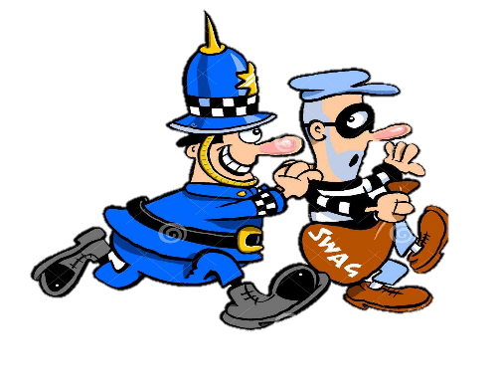
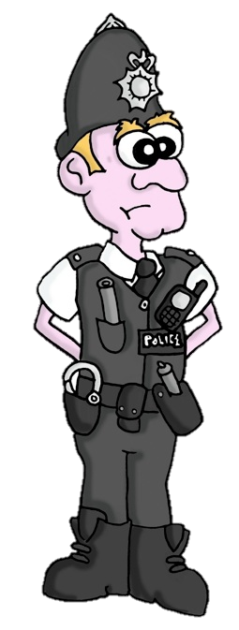
Lesson 1: Anglo-Saxon England – Overview of the course.
Background information:
Everything that you study in this unit of work will be examined in the first exam paper you sit. You are about to study how far our country has changed in terms of its crimes, laws, methods of law enforcement and types of punishments. The period of time covered in this unit stretches from c.1000 to the present day. You will also have a specific focus on the historical environment of Whitechapel in London. This will allow you to investigate original source material from the era of the 1880s and allow you to question more deeply why the police were unable to find the killer known as Jack the Ripper in 1888.
Crime and Law Definitions
Crime: An action that is against the law of the time.
Law: An act of parliament that has to be followed by everyone in the country. Breaking a law will lead to a punishment.
Decriminalise: Making a crime from the past, no longer a crime or illegal.
Heresy: A crime which aims to bring down the religion of the country.
Treason: A crime which aims to bring down the government of the country.
Petty Theft: The theft of very low value items.
Poaching: Illegally hunting on another person’s land.
Murder: The deliberate and planned killing of another person.
Manslaughter: An accidental or un-planned killing.
Hate Crime: A crime based on the discrimination against a particular faith or culture.
Law Enforcement Definitions
Law Enforcement: Methods which are used to make sure that individuals in the country do not break the laws.
Home Secretary: The member of the government responsible for the police and laws.
Collective Responsibility: The idea that all people in the community take responsibility for not breaking the law.
Forensic: The use of science to investigate a crime.
Oath: Swearing on the bible that a person has not committed a crime. A religious promise.
Vigilance: Members of a community taking the responsibility to bring a criminal to justice rather than the police.
Punishment Definitions
Punishment: A penalty for breaking a law. This can be an act of retribution, reformation or a deterrent.
Retribution: A type of punishment that is equal in size to the crime that has been broken.
Reformation: A type of punishment which aims to make sure the criminal changes their behaviour.
Deterrent: A type of punishment which is often harsh enough to persuade others in the community not to carry out the same crime.
Capital punishment: A punishment which results in the death of a criminal.
Corporal punishment: A punishment which results in the physical harm of a criminal.
Transportation: Moving a criminal to another country.
Borstal: A prison and work camp for young people.
Probation: The period of time after a prison sentence where the criminal is still supervised.
Period | Anglo-Saxon | Norman Britain | Late Medieval | Early Modern | Industrial | Twentieth Century
Date | c.410-1066 | 1066 - 1154 | 1154 -1485 | 1485 - 1700 | 1700 - 1900 | 1900 +
Famous events. | Viking invasions | Battle of Hastings | The Black Death | Tudors and Stuarts | Queen Victoria | World War One & Two.

Slide 3
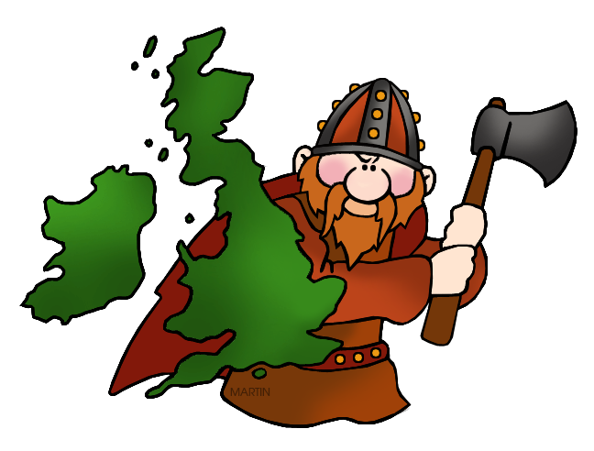
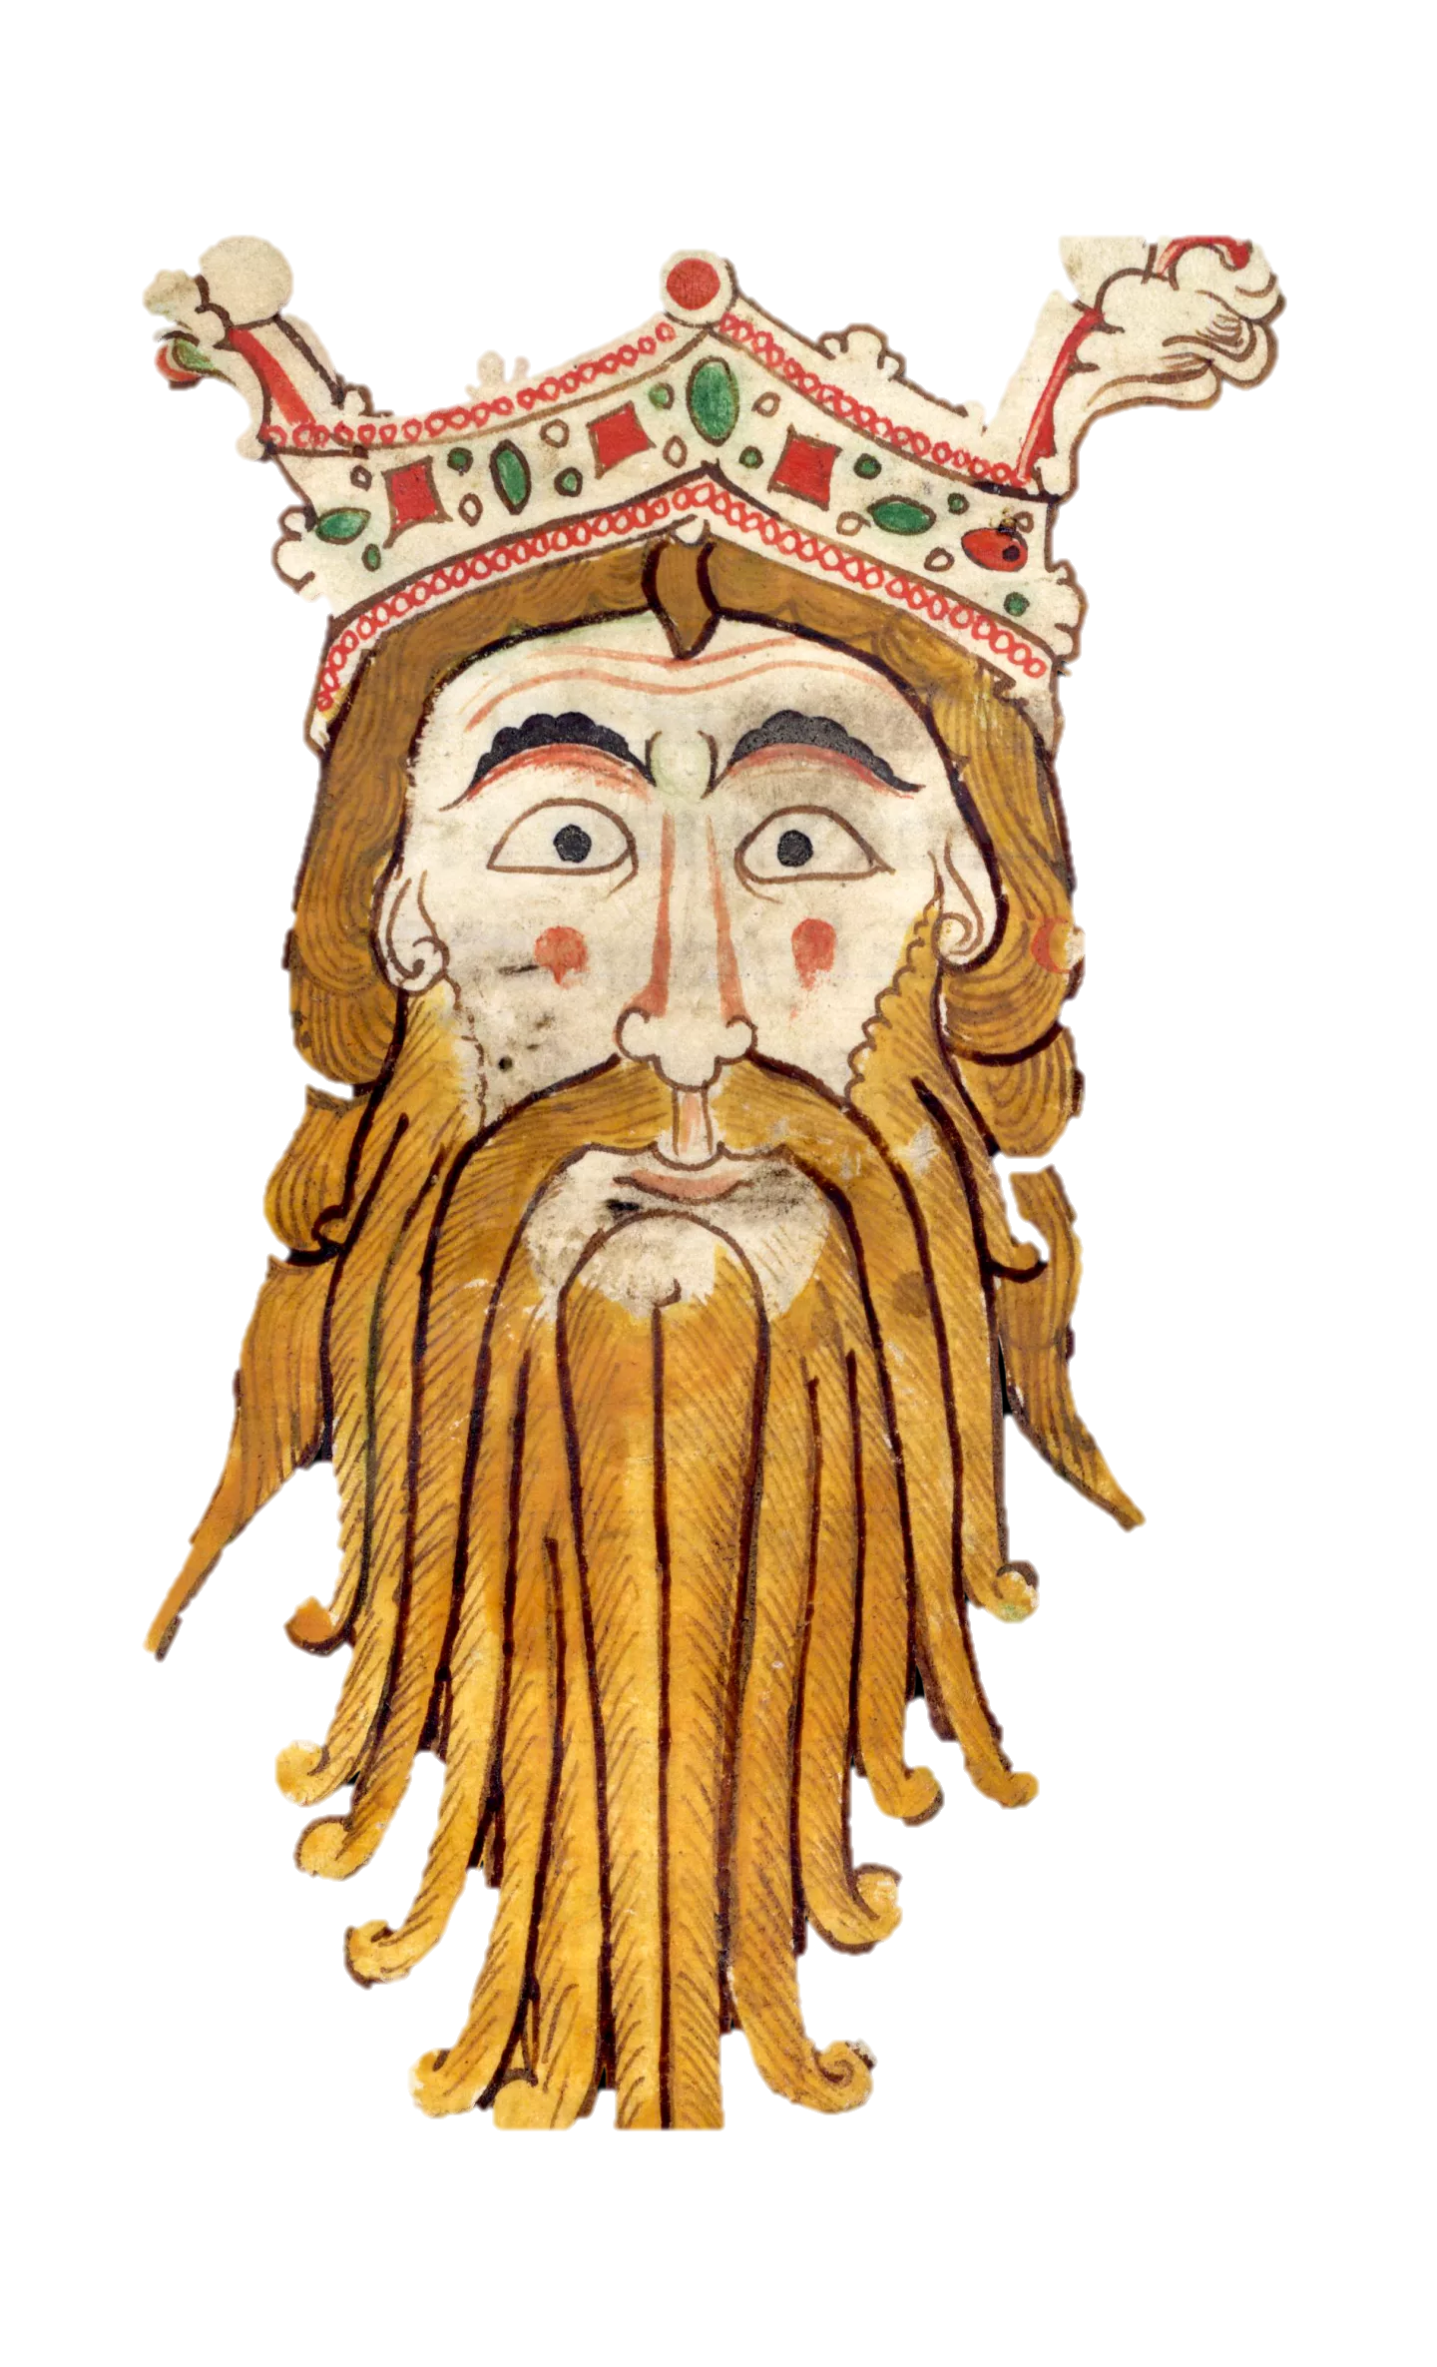
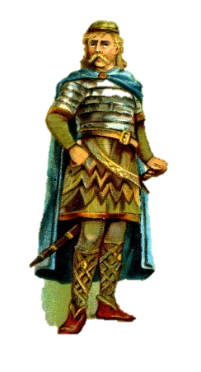
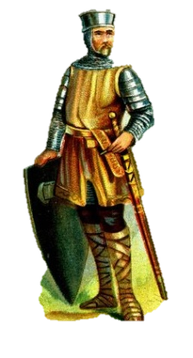
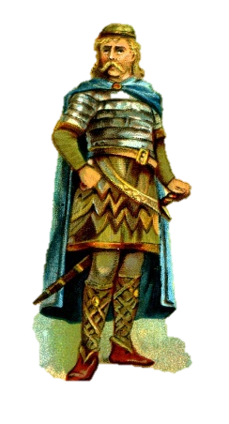
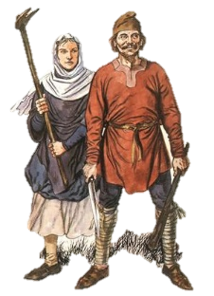
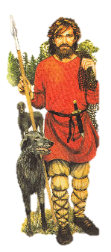
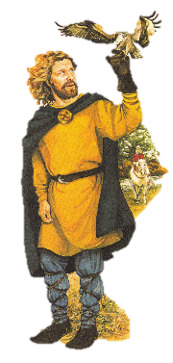
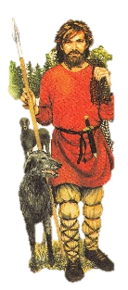
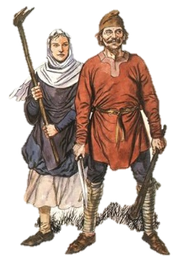
Lesson 2: Anglo-Saxon England – Types of Crime.
Background information:
It is believed that in 1000, the population of England was roughly 2,000,000 and 90% of people lives in the countryside, with very few towns developed. There was little communication and local communities were vulnerable to disease, poor weather and bad harvests. It was the King who made the law, but the local community who had responsibility to enforce the laws. The system of law and punishments was quite basic and relied on the local community. However, one powerful organisation with influence over crime and punishment was the Christian Church.
Who decided what a crime was and made the laws in Anglo-Saxon England?
The King relied on his advisors and the land owning nobles to help him rule the country. The other groups below the nobles had no say in how the country was ruled or the laws that were made. The nobles influenced the King hugely. They also did well from this as they could advise the King to make laws that would also protect them. For example, by punishing trespassers on their land harshly.
Britain was divided in a strict system of power, with the King at the top, followed by the wealthy and powerful Nobles, followed by the respected workers known as Freemen and then the Serfs, who owned no land and worked for very low pay. Any action which threatened this social structure was classed as a crime. For example, a Serf starting a fight with a Noble was seen as a high level crime. It would even be seen as an act of treason.
Treason is a term used to describe any action that challenges the authority of the King or more recently, the government. It is also and a type of crime known as ‘Crimes against Authority’. However, there was still a strong belief that it was still the King’s duty to keep the ‘King’s Peace’. It was the King who issued ‘codes of law’ and who had the right to change existing laws to make them stronger or to reduce their severity.
How the growth in towns influenced an increase in crime.
Some English towns grew in importance in this time such as Southampton, York and London. They grew due to increasing trade with Europe and links with foreign countries. For example, York still had strong links with the Viking ships which came over from Norway. This meant their population grew. With larger populations, there were more opportunities for crime. Two types of crime in particular became more common:
‘Crimes against the person’ – physical assault, theft from a person, fights and anything which involved causing physical harm to another person.
‘Crimes against property’ – These were crimes such as theft from a building, cattle theft, or being on another person’s land poaching (stealing).
The reason for the increase in these types of crime was how much easier it was to get away with a crime in a busy town where people did not know each other. Towns also had more valuable items for sale with their trade links and so there was more opportunity for criminals to steal.
KING
NOBLES
Crimes in the countryside and Collective Responsibility
In most village communities, most people knew each other. This made any criminal easier to identify and so fewer people risked committing a crime.
Local communities were expected to take Collective Responsibility. This meant being responsible for the actions of others and making sure friends and family were not tempted to break the law. It also meant being responsible to take action to find a criminal if any law was broken.
Each area also had a local official who was chosen by the community called a Reeve. The Reeve carried out decisions made by local courts to make sure any criminal was punished how the court decided.
The local church also played a vital role in the community.
FREEMEN
SERFS

Slide 4
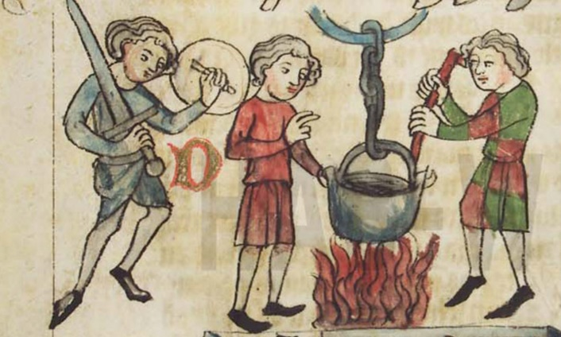
Anglo-Saxon Law Enforcement
There were 3 main beliefs about how the law should be enforced in this time:
Attitudes: It was the collective responsibility of the local community to police the actions and behaviour of others.
Religion: That God always had the final judgement on innocence or guilt due to how religious people were.
Society: That a person’s status/importance in society played a very important role in the law.
Lesson 3: Anglo-Saxon England – Methods of Law Enforcement.
Background information:
Last lesson we looked at how growing towns and trade links with Europe led to growing ‘crimes against the person’ such as theft. It is also important to remember that the King was responsible for making laws, had a duty to keep the ‘King’s Peace’, and was heavily influenced by the land owning nobles. It is also key to remember that the worst crime was any ‘crime against authority’, when the strict structure of society was threatened. This was known as treason. However, most people in Anglo-Saxon Britain still lived in rural villages and had the collective responsibility to enforce the law themselves. This lesson, we will look in more depth at how laws were enforced in the local community and the important role of religion and the church in helping people to do this.
The role of the community
It was always the victim’s responsibility to seek justice if a crime was committed against them. The whole community were expected to play a part in helping a criminal to be found and bring them to justice. Anyone who witnessed a crime or was a victim would raise the ‘Hue and Cry’. Literally, they would shout for help and everyone who heard this was expected to help capture the suspect. Being loyal to a community was seen as a duty and very rarely broken.
The role of Religion
Justice (deciding if a person is innocent or guilty) was influenced heavily by religion. The main methods of deciding guilty or innocence were by using OATHS and TRIALS.
STAGE ONE: Taking an Oath
Anyone accused of a crime would be taken to a public place. Here they could ‘swear an oath’ to declare they were innocent of a crime. They were also allowed to call on others in the village to support their oath. These helpers were known as ‘oath helpers’. In many cases, the accused walked free if this was their first crime.
STAGE TWO: A Religious Trial
If a person was caught ‘red handed’ (in the act of committing a crime) or they were a repeat offender, then they did not have the opportunity to swear an oath. This time the church would play the most important role. The suspect was taken to the church where they would be given a ‘trial by ordeal’. This decided if they were innocent or guilty in the eyes of God. It would be God who had the final judgement and bring about justice.
The structure of law enforcement in Anglo-Saxon England.
Shires: England was divided into large religions called ‘Shires’.
Hundreds: Shires were divided into ‘Hundreds’ and one man led this group called a Hundredsman.
Tithings: Each hundred was divided into a smaller group of 10 tithings. A tithing was a group of men big enough to enforce the law in a village.
Tithingmen: All men over the age of 12 had to be in a tithing at some point and this would be rotated in the village.
King’s Shire Reeve: One man from each tithing had to meet with a representative from the King known as the King’s Shire Reeve.
Trial by Hot Water
A person’s hand is placed in boiling water. It is then bandaged for a few days.
If the hand healed well, the church believed that God has judged the person to be innocent. If the hand did not heal or became infected, it was a signal that God has judged the person guilty.
Trial by Hot Iron
A person is made to hold a burning hot iron. It is then bandaged for a few days. If the hand healed well, the church believed that God has judged the person innocent. If it did not heal, it was a signal that God has judged the person guilty.
Trial by Cold Water
A person is thrown into cold water such as a river or stream which has been blessed by a priest. If they float, it is believed that God has ‘rejected’ them and judged them guilty. If they sank, God was willing to ‘accept them’ and they were innocent before being pulled up again.
Trial by Blessed Bread (Priests only)
A piece of bread was blessed by a priest. The accused is then asked to eat the bread. If the accused swallows easily, then God has judged them to be innocent. If the accused chokes or coughs when eating the bread, it is believed they are guilty.

Slide 5
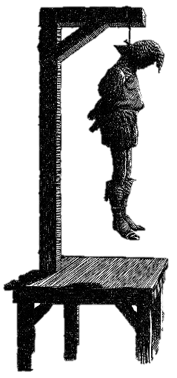
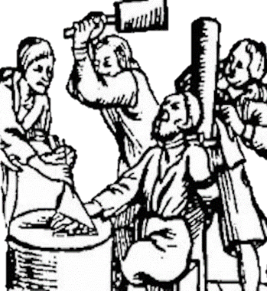
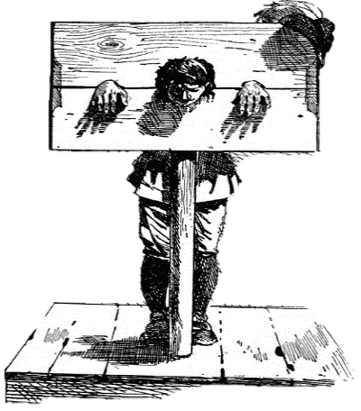
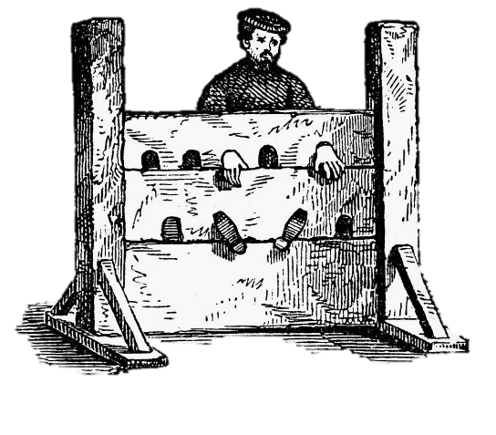
Lesson 4: Anglo-Saxon England – Punishments.
Background information:
For our last lesson covering the period of Anglo-Saxon England, we need to find out what types of punishments were carried out. Even though the trials we looked at last lesson, might seem like a punishment because of the pain they would cause, these were just a way to prove innocence or guilt. In Anglo-Saxon England, there were strict rules for the punishments that were given, depending on which social group a person belonged to.
The Wirgild
Even for the crime of murder, a compensation or fine would be made by the guilty individual to the family of the victim. This was compensation for the loss of life in the family.
The name of this fine was the wergild. This translates to the phrase ‘man price’. The money was paid directly to the victim’s family and it was meant as a way to simply stop the victim’s family from setting out to kill the murderer themselves, as this would just lead to more violence in the village.
However, a key feature of the wergild was how the amount paid in compensation would depend on the social status of the victim and the criminal. The table below shows how much a person’s life was worth.
Capital Punishments
A capital punishment is one that results in the death penalty.
The use of the death penalty was a form of retribution (to match the severity of the crime) and a form of deterrent (to frighten others in the community into not committing the same crime).
Treason and arson were seen as the two most serious crimes and most were punished with the capital punishment of hanging.
Arson was seen as serious as much land and property belonged to the nobility and the king, therefore it was seen as an attack on their authority.
Public Punishments
The Stocks and Pillory
This was the least harsh form of punishment but still acted as a deterrent to others and as a form of public humiliation.
The pillory secured a person with the arms and the head while they stood.
The stocks secured them at the feet while they sat down.
Those given this punishment would be placed in the middle of a village or town square and would often be given several days like this in poor weather. The public would then throw their rubbish and waste at them as well as verbally abuse the criminal.
A common crime which resulted in this punishment was public disorder - drunkenness.
Corporal Punishments
A corporal punishment is a term which includes a range of punishments which result in physical harm and pain to the body. The table below shows some examples of corporal punishments.
Even though some of the examples below sound very harsh, they were viewed at the time as being quite lenient compared with the death penalty. Also, any criminal with permanent disfigurement would also act as a deterrent to others in their community.
Corporal punishment | Description
Beatings | Carried out by the Shire Reeve, tithing men or local courts.
Mutilation | Physical harm to the body, resulting in permanent damage such as cuts and scars.
Branding | A heated poker pressed onto the skin until it burns.
Maiming | Removing a body part such as a tongue, a hand or an ear.
Social Status of the victim | The wergild to be paid to the family.
A noble | 1500 shillings
A freeman | 100 shillings
A serf | 40 shillings

Slide 6
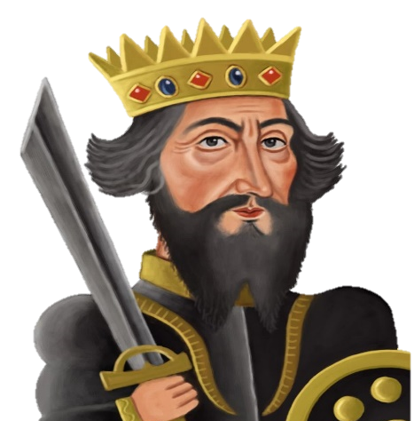
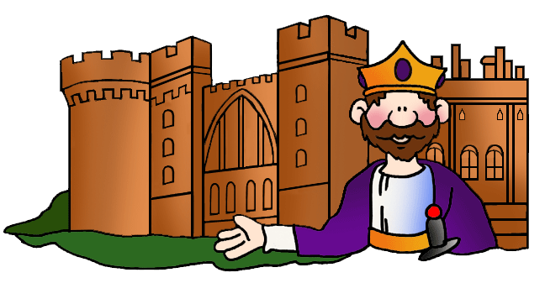
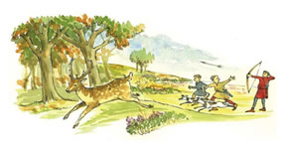
Lesson 5: Medieval England – How William the Conqueror Controlled the Anglo-Saxons.
Background information:
Our next Medieval period begins with the famous event of the Battle of Hastings in 1066. After William, Duke of Normandy’s victory over the Anglo-Saxons, a new era starts in Britain. William the Conqueror brought with him some new ideas about crime, law enforcement and punishments. However, he quickly realised that the methods used in Anglo-Saxon Britain were very effective and so many aspects of life continued. One big change however, was the increasing power that both the Norman Kings and the Christian Church played with crime and punishments. It was vital that William showed the Anglo-Saxons that his rule and his laws were to be taken seriously. He took several measures to make sure the Anglo-Saxons knew the law and respected his rule over England. By the end of this lesson, you will be able to identify what stayed the same (continuity), what changed and explain why William made these changes.
Dealing with Rebellions
Building Castles
Creating the Feudal System
Changes to the Law
There were still Anglo-Saxons who wished to break the law and challenge the authority of their new King. Remember, that a ‘crime against authority’ was seen as one of the more extreme crimes to carry out at this time. William therefore dealt with any rebellions harshly. He ordered brutal punishments for any rebels, but also their families and their whole community as a way to deter others. For example, farmlands and animals were destroyed for a whole village. It is estimated that up to 100,000 people died of starvation as a result of William’s actions.
Like the strict structure of society in Anglo-Saxon times, William made sure that society was organised carefully. In the Feudal System, everyone owed money and promised to serve the class above them. Only the King was free to do as he wanted. William replaced the Anglo-Saxon nobles with nobles from France to make sure they were loyal and his land was divided up among them. He also made sure he had a group of knights to fight for him if and when needed. This meant being a warrior had a high status and show control over the lower classes in society.
The Murdrum Fine
The Forest Laws – poachers and outlaws
The idea of paying a fine for murder stayed the same. However, William introduced two main changes to the law to show his authority.
Change 1: Unlike the wergild where the money would be paid to the family of the victim, the new Murdrum fine would be paid directly to the King. This was further evidence of how the laws were centralised.
Change 2: Rather than an individual paying the fine; the whole community would have to contribute. This meant the idea of collective responsibility was still used. It was also an even greater deterrent to committing murder knowing that a whole community had to pay
The Normans built castles in all parts of the kingdom. peasant workers were used to build the castles in which the Norman lords and nobles would live. This was another way for William to show his authority. The castle would then be used to control the local Anglo-Saxons but also physically demonstrate their power as many would be built on high land to keep a watchful eye on the villagers and look intimidating. The castles symbolised the increased strength and authority of the King over law and order in England.
William declared large areas of the English countryside as ‘Royal Forests’. 40 village communities were evicted from land to make way for William’s ‘New Forest’ in the south. These forests were to be a ‘royal playground’ for hunting. Only nobles and the King had a right to use them. This meant that land which had been used by peasants for grazing animals, collecting fire wood and catching rabbits was now controlled by the King and peasants banned.
Crime 1: Poaching
The crime for illegally entering the King’s land was called poaching. A poacher could be hanged, blinded or even castrated. However, many in a local community were unwilling to take collective responsibility to stop poaching they saw it as unfair as it took away their right to natural resources to survive.
Crime 2: Being an ‘outlaw’.
The Forest Laws created another crime. It became illegal for any peasant to move away from their village. Any that did this were called outlaws. If caught by the King’s men, outlaws could be killed there and then.

Slide 7
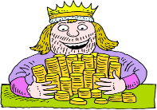
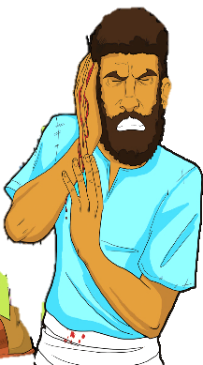
Lesson 6: Medieval England – Law Enforcement and Punishments after 1066.
Background information:
The methods used to enforce the law and punish criminals saw some change in this time but also a lot of continuity. One of the most significant reasons for this continuity was due to how effective it was at reducing crime. The use of a punishment as a deterrent was still key and most punishments were either fines, corporal punishments or hanging. In this lesson, we will investigate the similarities and differences between Anglo-Saxon and Norman law enforcement and punishments. This analysis of similarity and difference is particularly important to help you answer question 3 in your exam which specifically focusses on continuity or change.
Law Enforcement: Continuity
The King’s Duty
In Anglo-Saxon times, it was the King’s duty to protect his people. This was called keeping the ‘King’s Peace’. In Norman times, this idea remained. It was the belief that all men should expect to be safe from crime under the authority of the King. The Normans just called this something different. For them it was called the ‘King’s Mund’.
Trials
The system of trials by ordeal continued exactly the same as under the Anglo-Saxons. The only difference being that the Normans also used trial by combat (see below). It was still God who was thought to have the final judgement.
Collective Responsibility – tithings – hue ad cry.
The idea of collective responsibility within the local villages continued. Tithings were still used and included every man over the age of 12. The hue and cry also remained. These methods remained effective as many people still lived in small local villages where everyone knew each other.
Punishments: Continuity
Fines
Even though who the money was paid to changed under the Normans (see below), the fact that it remained a payment of money stayed the same.
Crimes against Authority
Another similarity was how any attempt to disrupt or challenge the King and his laws would be punished. In the same way, in both times this ‘crime against authority’ would carry the harshest punishment.
Punishments: Change
The Wergild
Rather than a criminal pay the compensation directly to the family of the victim, under Norman rule, the fine would have to be paid directly to the King. This way, punishments were becoming even more centralised rather than kept local. It proved the authority of the King and gave him extra revenue.
Brutal punishments
William needed to show his royal authority even more than the Anglo-Saxon kings, and there was still resistance from the Anglo-Saxon people who did not a foreign king. William used brutal force to make sure his people submitted to him.
Group punishments
He also made sure that large groups of people were punished as a way to show his power. E.g., farmlands and animals were killed as a punishment just to prove that he had authority. It is estimated that 100,000 people died of starvation as a result of the food shortages caused by William’s punishments towards rebelling Anglo-Saxons.
Increase in the use of the death penalty
Under the Norman Kings, there was an increase in the number of crimes that resulted in the death penalty. E.g., under the Forest Laws. A poacher would be punished by hanging. More common types of punishment used in the Norman period were mutilations, brandings. These were used as an alternative to capital punishments.
Law Enforcement: Change
Trial by Combat
A new trial was introduced by the Normans – Trial by Combat. This was used to settle any arguments over money or land. Two people would fight using swords, or sometimes large sticks. This was seen as a more dignified option for the wealthier classes. Occasionally, they would fight until the death and it was also introduced that anyone who ‘gave in’ would be punished by death anyway.

Slide 8
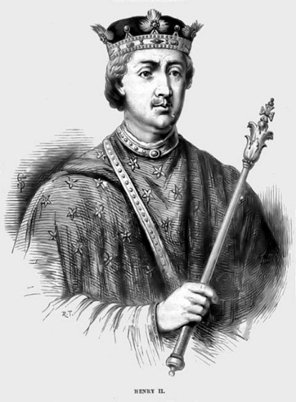
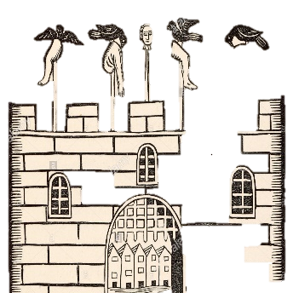
Lesson 7&8: Later Medieval England – Crimes, law enforcement and punishments.
Background information:
Anglo-Saxon England had come to and end after William the Conqueror and the Normans took control in 1066. By the late 1100s, there were more changes with crime and punishment in England. This period is known as the late Medieval or late Middle Ages. It saw an increased role for the King and his parliament and even more centralised legal system. By now, the King was meeting with his parliament and seeking advice from them about law and order. Many of these changes were brought in by King Henry II after he became King in 1154. Like the nobles, parliament had a big influence on the decisions made by the King.
The Role of Henry II: The Assize of Clarenden 1166.
The Assizes of Clarenden - These were a new set of rules to improve the way trials and courts were run. They made the process of enforcing the law even more centralised. He reorganised courts by making sure that a jury of 12 men from the local ‘hundred’ were used to help decide the verdict.
He also set up prisons to hold on to suspects before they went to a court.
He ordered royal judges called Justices of Eyre to visit each county twice a year to decide upon the most serious cases in the area. This made sure that the worst criminals were being judged by the king’s men and not the local community.
He introduced standardised written instructions to the local Shire Reeves. This meant rules and the way of running law and order was becoming more uniform (the same) across the whole country.
NEW LAW 1: The Statute of Labourers 1351
After the Black Death had killed 1/3 of the population, there was more work and fewer workers. Peasants started to demand higher wages. The ruling classes were worried that if the peasants were too wealthy they would gain more power and of course they wanted to keep the money themselves. As many members of Parliament wanted to protect their power and money, they all voted for the following changes known as the Statute of Labourers:
To keep wages the same as before the Black Death.
To make it illegal to ask for higher pay.
To make it illegal to move to a new area to look for better paid work.
CONTINUITY: Like the Norman nobility creating the Forest Laws, parliament had passed a law to protect their own power.
CHANGE: This was the first time parliament had played a role in passing laws, not just the King alone.
Law Enforcement
CONTINUITY:
Hue and Cry remained
CHANGE:
New Role #1
Coroners were introduced to investigate suspicious deaths.
New Role #2
Justices of the Peace were originally knights who were sent in to keep control of any particularly unruly places in bigger towns. By 1327, Edward III made sure all areas employed Justices of the Peace. They would help enforce the law and were given their orders directly from the King. They had a reputation for being harsh on poachers as of course, many were land owners themselves.
Why was a more centralised system of law and order used?
Towns such as London and York grew rapidly due to increased trade and the availability of work. London’s population was 30,000. This provided many more opportunities for crimes and to escape punishment for them.
Local people in smaller villages still had a responsibility to catch criminals, however, more centrally appointed officials (men employed by the King) were now being used rather than tithings or hundredsmen.
A change in title.
Tythingmen were still used in some areas, but had their title changed to ‘constables’.
Shire Reeves sent by the King were also still employed in local areas but their name had been shortened to a ‘Sheriff’.
NEW LAW 2: Heresy 1382
Heresy is the crime of disagreeing and acting against the beliefs of the Christian Church.
A very small number of people had started to question the beliefs and the actions of the Christian Church. They wanted change and especially wanted the bible translated into English for ordinary people to understand. The Kings were always very supportive of the clergy (members of the Church) and so introduced the law of Heresy as a way to stop the clergy feeling so threatened.
A person committing the crime of Heresy was known as a Heretic. Punishment for this was extreme – being burned at the stake. This would be a powerful deterrent to other heretics. The government and the church worked closely together to punish heretics. Justices of the Peace had to power to arrest suspected heretics.
Punishments
CONTINUITY
Punishments still fines, corporal punishments and executions.
CHANGE
Any person convicted of high treason (plotting to kill or betray the king) would be sentenced to be ‘hanged, drawn and quartered’. After strangulation, the stomach was cut open and organs ‘drawn’ out before death. After death, the limbs would be sent to different areas of the town for display as a deterrent.

Slide 9
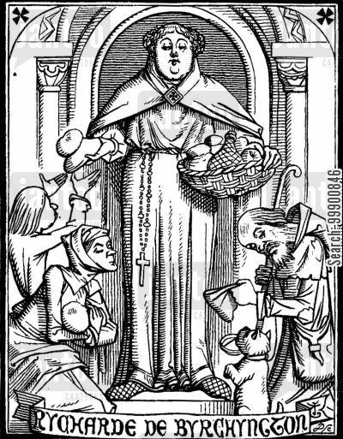
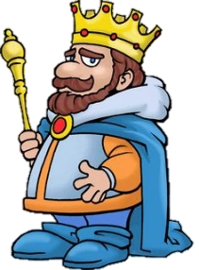
Lesson 9: Medieval Case Study – The role and influence of the Church.
Background information:
Throughout the Medieval period, religion played a key role in all areas of crime, law enforcement and punishment. The Church was one of the biggest influences on peoples life and it had enormous power. Nearly every person believed in the power of the Christian Church and so its role in law and order was never questioned in this time. However, towards the end of the Medieval period, one King in particular, Henry II began to challenge the authority of the church as he believed it should be the King who influenced law and order, not the church. Let’s look at the influence the Church had, how it gave criminals opportunities to avoid punishment and how Henry II started to reduce its power.
Why did the Church have so much influence over crime and punishment?
Members of the clergy were often the most educated members of a local community who were highly respected.
Churches were the largest building in a village and looked down on the villagers. It reminded people of God’s power over them.
The Medieval church taught that good or bad behaviour would influence whether a soul would go to Heaven or Hell.
The church was not just about prayer, 20% of the country’s wealth belonged to the church which also collected a tithe (tax) from all villagers.
The Christian church made sure that people remained Christian as they were starting to become aware of other religions such as Islam and Judaism.
A KEY CHANGE:
The end of ‘trial by ordeal’ in 1215.
The Pope, ordered priests to stop organising the trials ( see lesson 3). Without the priests, the trials soon came to and end. This was to prove how powerful the church was as even the King could not challenge the decision of the Pope. Another form of trial had to be found.
CHANGE: CHURCH COURTS
Courts, where decisions were made about a person’s innocence or guilt, were introduced to Britain by William the Conqueror.
The Church courts offered a way for a criminal to ‘reform’ (change their behaviour). For example, the church believed that a corporal punishment was better than a capital punishment as at least it gave a way for the criminal to think about their actions and change their behaviour.
However, this was not liked by the Kings who favoured harsher punishments.
CHANGE: THE KING VS THE CHURCH
For the first time, a King, Henry II tried to limit the power of the church. Henry II challenged the two ways that suspects could escape punishment for committing a crime.
These two methods were known as the Benefit of the Clergy and Sanctuary.
Never before had a King challenged the authority of the Church in matters of crime and punishment.
HENRY’S RELIGIOUS DISLIKE #1
Benefit of Clergy
Any member of the clergy accused of a crime, no matter how bad, was always put on trial at a church court.
PROBLEM: Church courts were far more lenient and rarely gave out the death penalty. A punishment might even be as simple as making a verbal apology in church. Many felt this was unfair.
PROBLEM: Anyone could say they were a member of the clergy. Even when tested to make sure they were a member of the church and asked to repeat a part of the bible, those who could not read just memorised it of by heart.
HENRY’S RELIGIOUS DISLIKE #2
Sanctuary
Sanctuary was when a church offered a safe place to live and hide in a church so they could be protected from arrest. Offering sanctuary remained until the rule of Henry VIII.
PROBLEM: Anyone could go to a church, ask for help. The priest would still report the crime but the clergy would then give the individual a chance to swear and oath agreeing to leave the country in 40 days rather than go to court.
PROBLEM: Some never left the country at all and just became an outlaw.
As King, I should have authority over the Church.

Slide 10
Key Terms | 1000-1500
Crimes & Laws
Law Enforcement
Punishments
What caused change in the period c.1000 – c.1500? | Explain
Key individuals
Monarchy
Politics/government
Religion
Society/attitudes
Economy/trade
Travel/immigration
Growth of towns & population
Period | Anglo-Saxon | Norman | Later Medieval
Crimes and Laws
Law Enforcement
Punishment

Slide 11
Explain one similarity/difference…[4] | Explain why… [12] | How far do you agree… [16]
Explain one way in which punishments before the Norman Conquest were different after the Norman conquest. [4] Explain one way in which punishments before the Norman Conquest were similar after the Norman conquest. [4] Explain one way in which law enforcement before 1066 was different after 1066. [4] Explain one way in which law enforcement before 1066 was similar in later Medieval England. [4] Explain one way that attitudes towards crime in Anglo-Saxon England were different after the Norman Conquest. [4] Explain one way that attitudes towards crime in Anglo-Saxon England were similar after the Norman Conquest. [4] | Explain why ‘trial by ordeal’ was used between c.1000 – c.1200. You may use the following information in your answer: Trial by hot iron Religion You must also use information of your own. [12] Explain why the Normans made changes to crime and punishment after 1066. You may use the following information in your answer: The Forest Laws The Murdrum Fine You must also use information of your own. [12] Explain why methods of law enforcement changed between c.1000 and c.1400. You may use the following information in your answer: The growth of towns Religion You must also use information of your own. [12] Explain why methods of law enforcement changed between c.1000 and c.1400. You may use the following information in your answer: The growth of towns Collective responsibility You must also use information of your own. [12] | ‘The Church was the most important factor influencing crime and punishment in the Medieval period’. How far do you agree? Explain your answer. You may use the following information in your answer: Church Courts The Norman Conquest You must also use information of your own. [16] ‘In the Medieval period, c.1000 – 1400, the main purpose of punishment was as a deterrent’. How far do you agree? Explain your answer. You may use the following information in your answer: Public hanging Church Courts You must also use information of your own. [16] ‘Law Enforcement was the responsibility of the local community between c.1000 and c.1500’. How far do you agree? Explain your answer. You may use the following information in your answer: Hue and Cry Justices of the Peace Act 1361 You must also use information of your own. [16] ‘William I’s Forest Laws were the most significant changes to crime after the Norman Conquest in 1066’. How far do you agree? Explain your answer. You may use the following information in your answer: Poaching The Murdrum Fine You must also use information of your own. [16]

Slide 12
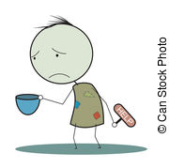
Lesson 11: 1500-1700 Tudor and Stuart – New types of Crime.
CRIME #1 – Heresy & Treason
Background information:
This period includes the rule of the Tudors & Stuarts in Britain. There were many changes to society, religion and politics in this time, as well as key developments in trade and exploration. All of these led to changes to law and order and the attitudes that ordinary people had towards crime.
By the 1500s, more people questioned the Christian religion and protested against some of the Catholic beliefs. These people were called ‘protestants’ and led by a German priest, Martin Luther.
They wanted the church to reform (change). This change was known as the Reformation. This created a divide between the traditional Catholic church and the ‘reformed’ Protestant church.
A person who committed heresy was known as a heretic. Treason was a challenge to the authority of the ruler. Anyone who challenged the ruler’s authority as the head of the Church of England would therefore be seen as committing heresy and treason. Put simply, a sudden change of monarch could result in a completely different set of laws about which religion to follow.
The main punishment for heresy was being burned at the stake. Not everyone accused of heresy was burned at the stake. Many took the option to ‘recant’ – to make a public statement that you have changed your religious beliefs.
CRIME #2 - Vagabondage
CRIME #3 – Poaching/trespassing
A bigger population, lower wages and higher prices led many to move into towns to find work. Monasteries which had previously offered charity were closed down. Many remained jobless and were known as vagabonds or vagrants. It was inevitable that many turned to crime as their only way to survive. They were viewed as lazy there was no sympathy towards them.
NEW LAWS:
The Vagrancy Act 1547 – Any vagabond without work to be punished.
The Relief of the Poor Act 1597 – harsh corporal punishments such as whipping or branding as a deterrent to other vagrants.
The Poor Law 1601 – Support known as ‘Poor Relief’ given to deserving poor such as the elderly and disabled. Undeserving poor would send to new ‘Houses of Correction where they were forced to work.
Like in Medieval England, those with land wanted to protect it from anyone using the land or stealing from it. The rural poor were used to using ‘public land’ to hunt for food or firewood. By the 1500s, more land owners were ‘enclosing’ the land (fencing it off) so they could use their land for themselves. Sheep farming made a lot of profit for the wool trade and parks were created for the rich. This made many of the rural poor struggle to survive.
NEW LAW:
1671 Game Act made hunting for animals and fishing illegal on enclosed land. This was a law that was seen as unfair and so it became a social crime. Poaching gangs were even formed in local villages. Of course the wealthier classes saw poaching as theft & demanded harsh punishments.
CRIME #4 - Smuggling
CRIME #5 - Puritan Crimes 1653 - 58
In the 1600s, the government made luxury goods coming into England such as tea and alcohol, more expensive by adding ‘import duty’ - a tax. Anyone who illegally smuggled these goods could make money by easily selling them cheaply. It was seen as a social crime as few people would report smugglers to the authorities. Even the rich were willing to take advantage of the cheaper prices for smuggled goods and so rarely reported them
After Oliver Cromwell’s victory over Charles I in the English Civil War, he became England’s Lord Protector. Cromwell was an extreme protestant called a Puritan and believed in strict rules on behaviour. Popular activities that were accepted by the monarchs before, were banned. E.g. Drinking alcohol, feasting and games were banned at Christmas. It proved again how a leader had central control over what was classed as a crime.
Henry VIII 1509-47 – Executed 81 people for heresy. Officially Catholic then made himself Head of the Church of England. Executed Catholics who would accept him as the Head of the Church.
Edward VI 1547-53: Highly Protestant. Executed 2 people for heresy. Introduced a bible written in English and during his short life span, imprisoned some Catholic bishops in the Tower of London.
Mary I 1553-58: Strict Catholic. Executed 283 people for heresy. Known as ‘Bloody Mary’ for her strict Catholic beliefs. Married to Philip II of Spain and tried to restore the Catholic church in England.
Elizabeth I 1558 – 1603: Executed 5 people for heresy. Protestant but aimed to find a ‘Middle Way’ with a Religious Settlement. Many Catholic plots against Elizabeth, including some supported by the Pope.
James I 1603 – 25: Protestant and fair towards Catholics until they aimed to kill him in the Gunpowder Plot of 1605. Introduced strict anti-Catholic laws.
CRIME #5 - Witchcraft
Most believed that witchcraft existed and people could do harm to others with supernatural powers. The monarchs and the ordinary people worried about the effects of witchcraft and so attitudes caused laws to become even harsher against those suspected of witchcraft. see lesson15

Slide 13
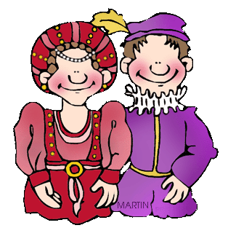
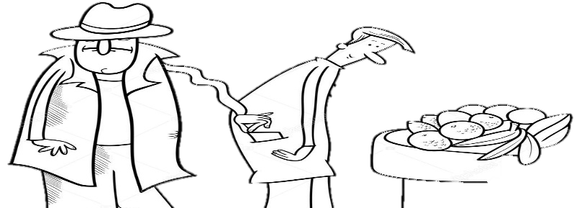
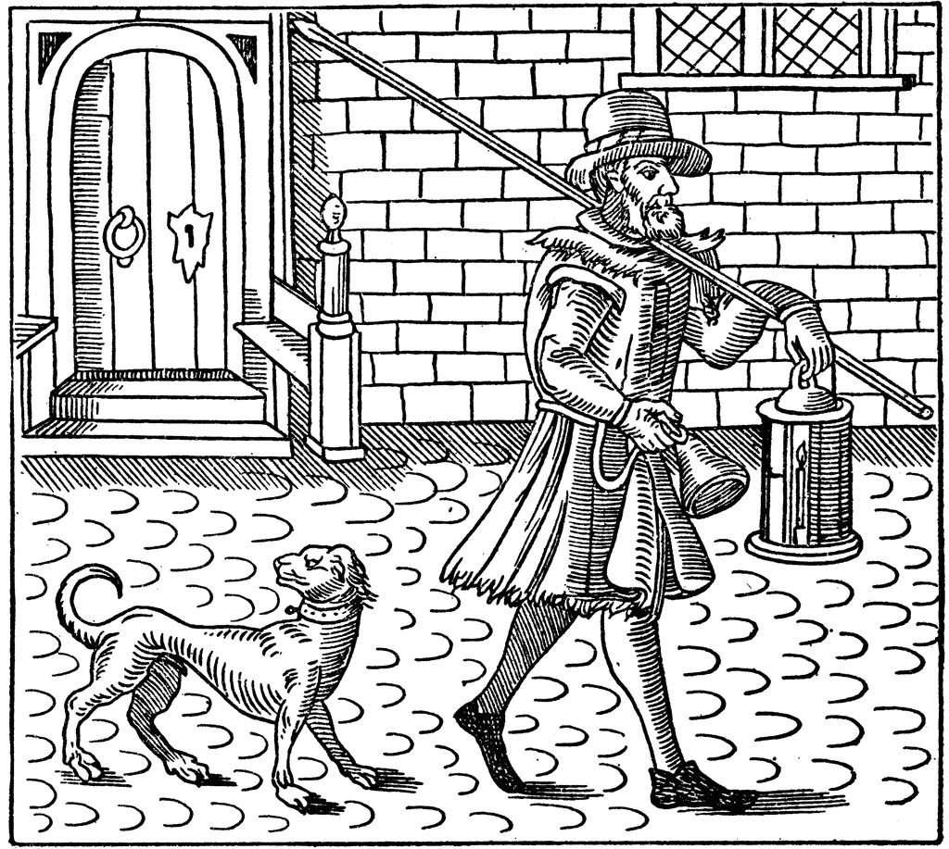
Lesson 12: 1500-1700 Tudor and Stuarts – Law Enforcement Methods.
Background information:
In this period we have already discovered that new crimes became part of law such as smuggling, vagabondage, witchcraft and the behaviours banned by Oliver Cromwell’s Puritans. However, some crimes stayed similar to those in Medieval England such as poaching illegally on privately owned land, heresy and treason. The increase in the number of crimes led to a need for more methods of law enforcement. More traditional methods had become less effective. One factor above all meant that the crime rate increased by the 1500s. This factor was the growth of towns.
THE IMPACT OF GROWING TOWNS
The population grew hugely between 1500 - 1700.
1500 = the population was roughly 2.5 million.
1700 = it had increased to roughly 6 million.
Population of London grew from 30,000 in 1400 to around 50,000 by 1700.
Ports such as Liverpool and Bristol grew massively due to increased trade. This also included the trade in people as this was the main time for Britain’s involvement in the Slave Trade.
WHY LIVE IN TOWNS?
More people decided to move to towns to find work. Towns were more likely to have links with trade & transport. Towns could be more exciting & offer opportunities.
HOW GROWING TOWNS INCREASED CRIME
Theft increased due to more opportunities to steal in more crowded areas, without being caught.
Fewer people knew each other so criminals were difficult to hunt down and identify. Especially with no system of organised law enforcement.
An increase in the poor from the countryside meant fewer jobs – those without work turned to crime just to survive.
Towns provided more goods to steal on markets and in shops.
The rich tended to live in towns and so they were more of a target.
In more crowded places, pickpockets had more opportunities for theft.
Fraud would be more common with a lot more businesses.
ROLE #1: The Town Constable
Town constables had been introduced before 1500 but were widely more used after 1500.
They were employed and paid by the town authorities.
They were chosen by local people.
They had some powers of arrest
Would help collect fines.
They were expected to break up fights & stop criminals if they ran away.
They were expected to round up beggars and vagabonds.
They were expected to take criminals to the courts.
NEW METHODS OF LAW ENFORCEMENT
What aspects of law enforcement CONTINUED?
Village and smaller town communities still expected to take the leading role in catching and chasing down criminals.
Villages stayed smaller with people knowing each other.
There was still no national, organised form of policing and law enforcement.
Standards of law enforcement and policing varied depending on where in the country a person lived.
ROLE #2: The Night Watchman
Their work was monitored by the town constable.
All males in a town were expected to be a night watchman at some point.
They would patrol between 10pm and dawn.
They were unpaid and still expected do their normal job.
They had a responsibility to ring a bell to warn people to get indoors if a criminal was on the loose.
They would carry a candle lamp to help with the patrol.
ROLE #3: Thief Takers
Town Constables and Night Watchmen not that effective so some people hired thief takers.
A thief taker was hired to catch a criminal and take them to the police. They would receive a reward for doing this from the person who had hired them.
This form of law enforcement was ‘unofficial’ and open to corruption. Their methods could be violent.

Slide 14
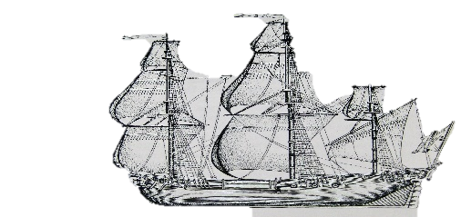
Lesson 13: 1500-1700 Tudor and Stuarts – Punishments and the Bloody Code.
Background information:
The period between 1500-1700 saw a change in the type of punishments used. While more traditional forms of corporal punishment continued, other types of punishments were created as a way to control the increasing number of criminals. The new forms of punishment were transportation and the use of prisons to punish criminals rather than just keep them before their trial. Capital punishments continued to be used. The key difference was the dramatic increase in the number of crimes that would result in the death penalty. This common use of the death penalty was known at the time as the ‘Bloody Code’.
*CONTINUITY WITH PUNISHMENT BETWEEN 1500-1700*
Many old corporal punishments remained such as fines, pillory or stocks, corporal (whipping, maiming, branding etc.), hanging, burning. Punishments were also still used as a form of retribution and deterrent. Most people still believed in this type of punishment as effective.
*CHANGE WITH PUNISHMENT BETWEEN 1500-1700*
Transportation and the Houses of Correction were seen by some as a chance for the behaviour of a criminal to improve through hard work. This punishment was a form of rehabilitation or reform rather then just a simple deterrent.
*NEW PUNISHMENT*
Transportation To North America
From the 1600s, some criminals were transported to the English colonies in North America.
Although prisoners were not given the death penalty, it was still a harsh punishment.
Prisoners were taken in chains, held under the decks of a ship and taken to North America. They would have to carry out tough physical labour for between 7 - 14 years.
They were freed at the end but with no money they would have little chance returning.
Who and how many?
Between 50,000 and 80,000 people were transported to North America before 1770.
This would include men, woman and children.
King James I gave permission for vagrant children in London to be arrested and transported. They were called ‘duty boys/girls’ Many died due to conditions on the ship.
*NEW PUNISHMENT*
Early prisons as a punishment
Before 1500, a prison was just a place where people waited before their trial. They were not purpose built – just a locked room in a local castle or village building.
Conditions in these early prisons:
Prisoners had to pay the wardens for food and clothing. If they could not pay they went without.
Women, men and children all locked together. Petty criminals and murderers all locked together in the same space. Conditions were dirty and prisoners died of diseases such as typhus.
*NEW PUNISHMENT*
Houses of Correction
By 1556, newer, purpose built prisons called ‘Houses of Correction were built. The first was Bridewell Prison in London. It was used to punish poor people of all ages who had broken the law
All inmates had to do hard labour such as breaking up rocks to pay for their keep and encourage them to work harder after their release. This was seen as a form of rehabilitation and reform as well as deterrent.
This prion influenced other prisons to open up around the country.
Why was transportation introduced?
EXPLORATION to the New World made this possible.
POLITICAL/POWER - Sending criminals to North America was another way of increasing the population of a colony and to help build it up.
SOCIAL - It was seen as a way of removing criminals from the people who had influenced them into crime in the first place. Also, the poor were blamed for spreading plague, it was an easy way to remove this risk.
CHANGING ATTITUDES: It was hoped a new start, especially for younger criminals would be a form of rehabilitation. It was seen as more effective form of a deterrent.
ECONOMIC/SOCIAL - There was no organised prison system, so this was a way to deal with criminals to keep them off the streets.
CAPITAL PUNISHMENT –
THE BLOODY CODE
The number of crimes resulting in the death penalty increased. There were 50 capital crimes by 1688. Some of these crimes seem minor e.g. poaching.
The harsh punishments given in this time have been known as the BLOODY CODE.
They were simply intended to be a strong deterrent – to stop the crime rate increasing. but also a method used to simply remove the criminal altogether to prevent them ever committing a crime again.
Why did the idea of a deterrent NOT work?
Most crimes were out of desperation – poverty led people to take extreme measures to feed themselves.
Criminals could even receive a pardon (let off) if they could prove they had a good character.
Plead for belly – women were often not given the death penalty if a doctor believed they were pregnant.

Slide 15
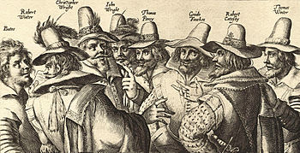
Lesson 14: 1500-1700 Tudor and Stuarts – Case Study of The Gunpowder Plot 1605.
Background information:
The Gunpowder Plot is one of the most famous events in English History. Protestant King James I took over from Elizabeth I in 1603. After only two years in charge, a gang of Catholics attempted to blow up the Houses of Parliament, kill the king and restore the Catholic faith to England. The plot failed, the gang led by Robert Catesby were arrested, taken to the Tower of London, tortured and then executed. This one event can help you understand the importance that religion still played by the 1600s, provide an example of high treason, give evidence of the use of a brutal punishments given to the plotters which was to act as a deterrent to other Catholics and the way this crime led to further anti-Catholic laws.
Why were Catholics still motivated by their religion?
After Elizabeth I’s death, they hoped the new King would be more sympathetic to Catholics. They were disappointed when he announced even stricter anti-Catholic laws.
Many Catholics still remained in England despite the country being officially Protestant since the beginning of Elizabeth’s reign in 1558.
The leader, Robert Catesby had a family history of supporting the Catholics.
The Pope had excommunicated Elizabeth I for her Religious Settlement and encouraged Catholics to challenge the monarchy.
There were strict rules against Catholics. They had to attend Protestant church services and any Catholic who refused would be fined.
What were the main aims of the Catholic plotters?
The Gunpowder Plot aimed to blow up the Houses of Parliament and kill the King on 5th November 1605.
Many Protestant members of parliament would be present and it was planned to remove this powerful group of protestants to replace them with Catholics.
What was their plan?
1 ton of gunpowder was stored below the Houses of Parliament. However, a letter was sent warning of the plot on the 20th October 1605.
Historians believe the plot was known about but it was left until the ‘last minute’ to discover the plotters to create more drama and give the government a reason to be even more anti-Catholic.
How did the law change as a result?
Two new Laws:
1605 Thanksgiving Act which made November 5th an event that should be commemorated (remembered) every year.
The 1606 Popish Recusants Act forced Catholics to swear an oath of allegiance to the King.
Other restrictions:
Catholics were banned from working in the legal profession or being an officer in the army.
Catholics were restricted in voting, becoming MPs or owning land.
James I published a book, describing the events and encouraged even more anti-Catholic views.
After this plot, England has remained Protestant.
The use of torture and the trial
The King allowed the use of torture.
The rack was used which was located in the Tower of London.
After 12 days of torture Guy Fawkes gave the names of the other plotters. They were all found guilty of treason.
Why was the punishment so brutal?
The King and his government wanted to make the punishment so harsh, that it would act as a clear public deterrent to any other Catholics who may be plotting against the King.
What was the punishment?
All men were sentenced to be hanged, drawn and quartered in public. This meant being hanged until they lost consciousness, then revived, then had their genitals cut off before their insides pulled out and head chopped off. Their body parts were then displayed in public.

Slide 16
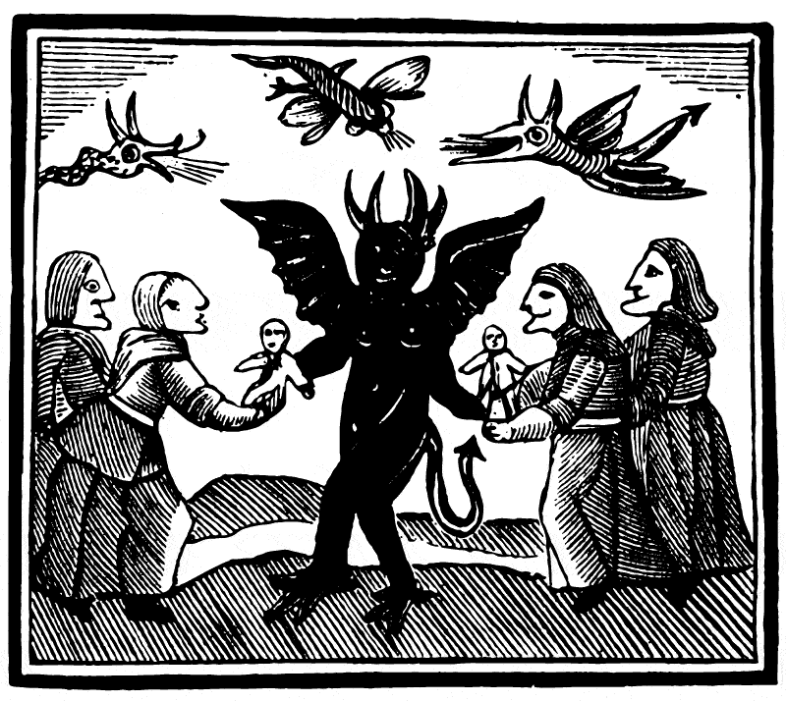
Lesson 15: 1500-1700 Tudor and Stuarts – Case Study Matthew Hopkins and Witchcraft.
Background information: Being Catholic was not the only religious factor that caused a problem with the law, there was a deep rooted belief by rich and poor in the supernatural between 1500-1700. Many people believed in the existence of witches who could cause harm by using evil spirits and summoning the powers of the Devil. This can again prove how religion and people’s attitudes shaped the laws that existed in this time. It also proves how key individuals such as Matthew Hopkins could use these fears to their advantage. However, by the late 1600s, attitudes did begin to change and a new enlightened, ‘scientific’ way of thinking meant the end of the belief in witchcraft for most people.
Witchcraft Laws
If something is an official law, it makes the population feel that their belief is even more real, especially if their trusted monarch had agreed to it.
CHANGE: In the Middle Ages, church courts were used to try witches but the punishments were not that severe. Laws after this gave harsher punishments.
WITCHCRAFT LAWS
Henry VIII’s Witchcraft Act:
Witchcraft to be punished with death.
Elizabeth I’s Act against Enchantments and Witchcraft
Witchcraft now tried in ordinary courts not the church courts. Death penalty remained.
James I’s Witchcraft and Conjuration Act
Death penalty to anyone summoning ‘evil spirits’.
The Influence of Religion.
Religion played a key part in influencing attitudes in this time. Everyone believed in God (Heaven) and were afraid of the Devil (Hell).
This made witchcraft an easy belief to have.
James I argued that witchcraft was a crime against God himself.
The Civil War brought Protestants against Catholics and so religion became even more important in people’s lives.
The war caused disruption, chaos, anxiety and fear. This fear led to people believing in more extreme and superstitious ideas about magic.
FACTORS THAT INFLUENCED THE BELIEF IN WITCHCRAFT
The influence of Matthew Hopkins
Matthew Hopkins was a former lawyer who in 1645 called himself the ‘Witchfinder General’.
He was employed in the east of England to hunt down witches to take to court. He would be paid well for each witch.
Hopkins created fear and panic which swept the east of England. He investigated around 300 people and 112 were executed.
The Influence of James I
James I believed hugely in witchcraft. He even published a book called Demonologie in 1597. It included reasons for believing in witches, ways to identify them and encouraged readers to hunt them down.
After the failed plot against him in 1605, he was obsessed with uncovering threats against him so encouraged even more witch hunts.
Attitudes towards women
90% of all accusations were made against women.
Part of this is down to the lack of power and responsibility women had in society – they were easy to target and blame. For example, any woman in a village who was not married, who had been childless, poor or vagabond were a target.
It was believed that women were weaker and easily influenced by the Devil.
Economic influences
Low wages, high unemployment and poor harvests caused anxiety and tension. It was easy to blame the death of animals or poor harvests on witchcraft, especially at a time with little understanding of science.
The rich were becoming more fearful of the poor, especially vagabonds. Many accusations were made by the rich against the poor as a result.
Witchcraft Trials
He used a range of interrogation methods used to get confessions, starvation & sleep deprivation.
He examined the body to find ‘Devil Marks’ such as a teat (nipple) for the familiar to suckle blood, birth mark or large mole.
Few people dared to speak out against Matthew Hopkins as they were frightened they would become targets themselves.
Why did the belief in witchcraft decline by the 1700s?
The time around 1650 was known as the Enlightenment. Some people questioned the world in a more scientific way.
The Royal Society was created in London in 1660 and brought together these scientists. It encouraged further research into medicine, astronomy and physics and was supported by a ‘Royal Charter’ from King Charles II which proved it now had official royal backing.
Witchcraft then became seen as a superstition believed in by the poor or uneducated rather than a crime.
However, attitudes were slower to change in some more rural and isolated places.
The last accused witch to be executed was in 1716.
Punishments for Witchcraft
An estimated 1,000 people were executed for witchcraft between 1542-1736.
Hanging was the most common form of execution.

Slide 17
Explain one similarity/difference…[4] | Explain why… [12] | How far do you agree… [16]
Explain one way in which punishments in the 16th century were different in the 12th century. [4] Explain one way in which punishments in the 16th century were similar in the 12th century. [4] Explain one way in which prisons in Medieval England were different in the 1600s. [4] Explain one way in which law enforcement in Medieval England was similar in the 1600s. [4] Explain one way that attitudes towards crime in the 12th century was different in the 17th century. [4] Explain one way that attitudes towards crime in the 12th century was similar in the 17th century. [4] Explain one way that attitudes towards witchcraft in the 12th century was different in the 17th century. [4] Explain one way that attitudes towards witchcraft in the 16th^{th} century was different at the end of the 18th century. | Explain why there was a change in the number of capital punishments in the period 1500-1700 You may use the following information in your answer: The Bloody Code Population increase You must also use information of your own. [12] Explain why there were changes in punishments for witchcraft in the period 1600 – 1750. You may use the following information in your answer: Matthew Hopkins The Royal Society You must also use information of your own. [12] Explain why methods of law enforcement changed between c.1500 and c.1700. You may use the following information in your answer: Town Constable Population growth You must also use information of your own. [12] Explain why the methods of punishment changed between 1500-1700 You may use the following information in your answer: The Bloody Code Colonies in North America You must also use information of your own. [12] Explain why the King and government took vagabondage so seriously in the years 1500-1700. You may use the following information in your answer: Poaching Witchcraft You must also use information of your own. [12] | ‘The Church was the most important factor influencing crime and punishment in the period 1500 - 1700’. How far do you agree? Explain your answer. You may use the following information in your answer: Witchcraft Smuggling You must also use information of your own. [16] ‘In the period 1500-1700, the main aim of a punishment was as a deterrent’. How far do you agree? Explain your answer. You may use the following information in your answer: The Gunpowder Plot 1605 Transportation You must also use information of your own. [16] ‘The most important factor influencing witch hunts in the years 1500 – 1700 was religion’ How far do you agree? Explain your answer. You may use the following information in your answer: Matthew Hopkins The English Civil War You must also use information of your own. [16]

Slide 18
Key Terms | 1500-1700
Crimes & Laws
Law Enforcement
Punishments
What caused change in the period c.1500 – c.1700? | Explain
Key individuals
Monarchy
Politics/government
Religion
Society/attitudes
Economy/trade
Travel/immigration
Growth of towns & population
Changes/difference with Medieval England | Continuity/Similarity with Medieval England
Crimes and Laws | Crimes and Laws
Law Enforcement | Law Enforcement
Punishment | Punishment

Slide 19
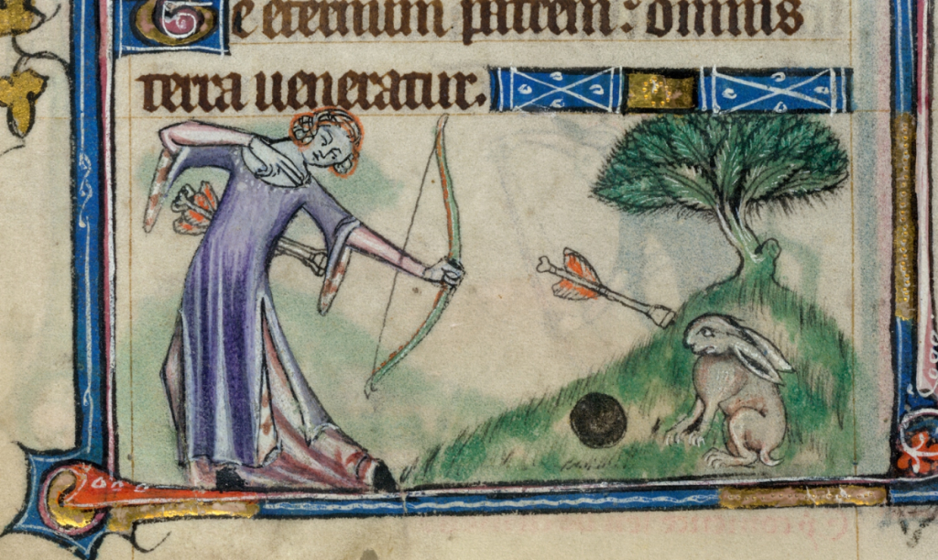
Lesson 16: 1700-1900 Victorian England – Types of Crime: Smuggling, highway robbery and poaching.
Background information: By the 1700s, Britain was changing quickly. The population would increase to nearly 40 million by 1900 and vast numbers of people moved to towns using new forms of mechanised transport. This caused an increase in a new crime called highway robbery. There was also a huge shift in people’s attitudes and beliefs which led to a reduction in religious based crimes such as the decriminalisation of witchcraft. People in England were also more settled with their belief in the Protestant faith so fewer crimes were committed that were classed as treason. Some crimes saw a mix of continuity and change, especially smuggling and poaching.
Smuggling
What was smuggling?
Smugglers were still bringing goods into the country without paying tax/duty – then selling goods illegally. They were able to sell the goods cheaper and make a bigger profit.
Type of crime
Social crime – many people benefitted from cheaper goods, and did not see it as wrong. They were less likely to inform the authorities. Some smugglers were seen as local heroes. Even the upper classes would buy luxury goods illegally and not want to inform.
Continuity
Authorities still found smuggling hard to tackle.
Smuggling was still taking place at night on small boats around the coast so they were difficult to catch.
Change
Smuggling increased as even more goods now had import duty: cloth, wine, salt, leather and soap.
Larger smuggling gangs appeared. E.g. The Hawkhurst Gang who controlled smuggling along the south coast. Gangs were better organised than earlier smugglers.
Some leaders (Arthur Gray and Thomas Kingsmill) were hung as a punishment.
Why did it decline?
Prime Minister, William Pitt, reduced import duty. This made goods cheaper to import anyway. By the end of the period, smuggling reduced as the profit became less.
Poaching
What was poaching?
Illegally hunting/taking natural resources on private land.
Continuity
The group mainly responsible were the poor, who often did it just to survive.
The poor did not report poachers as they saw it as unfair.
The rich still ruled the land & made the laws strict.
Change
There was a rise in poaching gangs who were better organised and worked on a larger scale.
More poaching forced the authorities to make the laws even harsher. Punishments became more extreme as a deterrent.
1723 Black Act made poaching a capital offence (death penalty). It also made it illegal to own a trap or even owning hunting dogs near restricted land. This could end in a fine or prison sentence.
The Black Act was repealed (stopped) in 1823 when Robert Peel changed the law to remove the death penalty.
Highway Robbery
What was Highway Robbery?
Attacking travellers and forcing them to hand over goods
Robbers on horseback were called ‘highwaymen’.
Example of a famous highwayman – Black Harry in Derbyshire who was eventually caught and executed.
Why was it such a serious crime?
It disrupted trade and travel between towns.
The crimes were committed on the ‘King’s Highway’ so it was seen as an act of treason.
In 1772 – the death penalty was introduced.
Continuity
It had taken place as far back as the Middle Ages as the rich and tradesmen would travel between towns.
Change
Highway robbery dramatically increased.
Trade around the country increased so there were more people out on the tracks/horseback with cash or goods.
With no banks to keep money, the rich would have to carry cash with them so they were easy targets.
When out of towns, the tracks were very isolated. This made the robbers difficult to catch.
Regular ‘stagecoach’ services for the rich between towns which meant more opportunity for crime.
Why did it decline?
Patrols on the roads of officers on mounted horseback – this made it easier to catch.
Banks developed and so there was less need for people to carry their cash around with them. It could be stored safely.
The last case of a highway robbery was in 1831.
The decriminalisation of witchcraft
1716 – The last witchcraft execution was is 1716. By 1735 the Witchcraft Act – meant Witches were now just seen as tricksters. The punishments were much less severe such as fines.

Slide 20
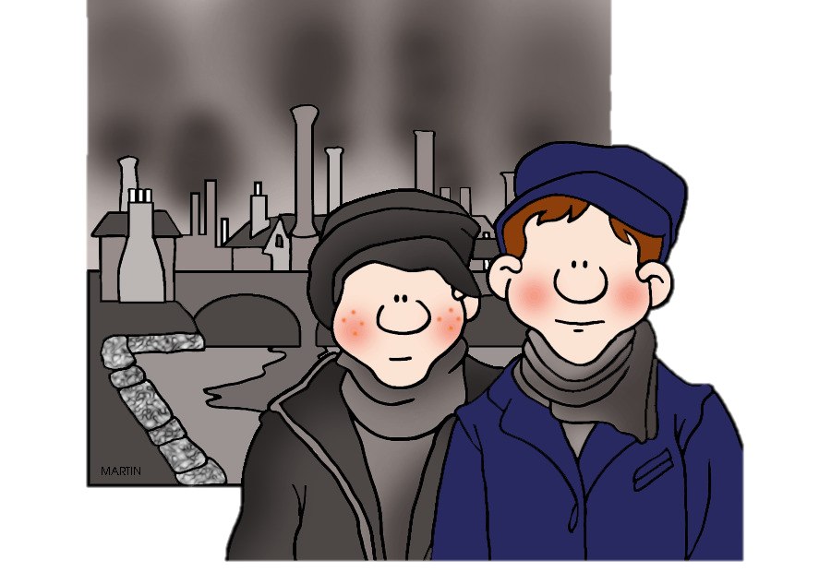
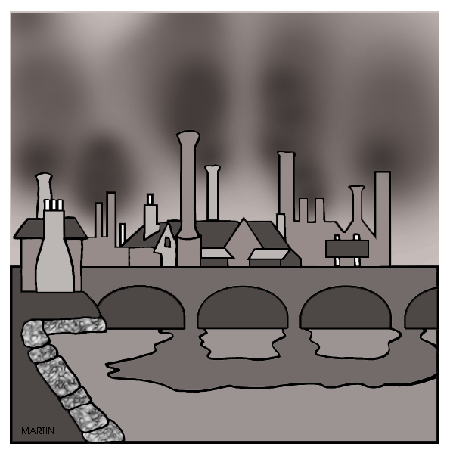
Lesson 17: 1700-1900 Victorian England – The Impact of the Industrial Revolution.
Background information:
It is possible that you may be asked to explain why there were changes to crimes, law enforcement and punishments between 1700-1900. Most of the era between 1750 and 1900 has been known as the Industrial Revolution. Many changes took place to the population, mechanisation, transport, exploration and the economy. Below are a number of factors you could use to explain the changes towards law and order in this time. For each factor, think of the impact it would have had and how it could explain some of the crimes, methods of law enforcement and punishments.
Population rise and movement. 1700 - Only 9 million people who mainly lived in scattered villages in rural areas. 1900 - 41.5 million people with a mass migration to towns due to urbanisation and industry. | Work 1700 – most people made a living with farm work in rural areas. 1900 – most people found work in busy factories, workshops or mills in or near towns. | Voting Rights 1750 – Only one in every 8 men could vote. 1885 – Nearly all men had this right. Governments now had to take notice of the needs of all voters, not just the rich and powerful. | Agriculture 1700 – Poor harvests more common due to simple farming methods. 1900 – Better knowledge of farming and food. Food could be produced easily and imported cheaply from abroad. | Politics and government 1700 – The government was led by rich and powerful landowners who would only look after their own interests. 1900 – The government had a wider role to look after the wellbeing of ordinary citizens.
Travel 1700 – Basic mode of travel using horse and cart on gravel tracks. Weather could affect this. 1900 – Huge improvement with railways, steam power, canals. Transport much cheaper and quicker – especially for ordinary people, not just the rich. | Economy/Trade 1700 – Some trade outside England for luxury goods such as tea, sugar, tobacco. A time of the Save Trade. 1900 – Britain now a leading trading country. Links with all parts of the globe to a variety of cheaper goods. The government collecting higher taxes which they could use to make changes to law enforcement and punishments. | Education 1700 – A small number of richer children educated and literate. 1900 – 95% of the population could read and write. The law made all children go to school until the age of 13. It was possible for ordinary people to make an impact if they wanted to as they were more educated. | New beliefs and attitudes 1700 – New ideas had just started to appear about science, medicine and the world. The Enlightenment had some impact. England still a highly religious country. 1900 – Charles Darwin’s theory of evolution started to make people believe that some people were born as ‘criminals’. Humanitarianism gave people a belief that human beings could be rehabilitated and reformed. Religion being challenged further by science. | Taxes 1700 – Fewer people in the country would work, and so the government got a limited amount of money from taxes. 1900 – With a huge population and many in work, the government had much higher taxes and could spend this money developing new forms of law enforcement and punishment systems.

Slide 21
Lesson 18: 1700-1900 Victorian England – The Impact of the Industrial Revolution.
Background information:
It is possible that you may be asked to explain why there were changes to crimes, law enforcement and punishments between 1700-1900. Most of the era between 1750 and 1900 has been known as the Industrial Revolution. Many changes took place to the population, mechanisation, transport, exploration and the economy. Below are a number of factors you could use to explain the changes towards law and order in this time. For each factor, think of the impact it would have had and how it could explain some of the crimes, methods of law enforcement and punishments.
Population rise and movement. 1700 - Only 9 million people who mainly lived in scattered villages in rural areas. 1900 - 41.5 million people with a mass migration to towns due to urbanisation and industry. | Work 1700 – most people made a living with farm work in rural areas. 1900 – most people found work in busy factories, workshops or mills in or near towns. | Voting Rights 1750 – Only one in every 8 men could vote. 1885 – Nearly all men had this right. Governments now had to take notice of the needs of all voters, not just the rich and powerful. | Agriculture 1700 – Poor harvests more common due to simple farming methods. 1900 – Better knowledge of farming and food. Food could be produced easily and imported cheaply from abroad. | Politics and government 1700 – The government was led by rich and powerful landowners who would only look after their own interests. 1900 – The government had a wider role to look after the wellbeing of ordinary citizens.
Travel 1700 – Basic mode of travel using horse and cart on gravel tracks. Weather could affect this. 1900 – Huge improvement with railways, steam power, canals. Transport much cheaper and quicker – especially for ordinary people, not just the rich. | Economy/Trade 1700 – Some trade outside England for luxury goods such as tea, sugar, tobacco. A time of the Save Trade. 1900 – Britain now a leading trading country. Links with all parts of the globe to a variety of cheaper goods. The government collecting higher taxes which they could use to make changes to law enforcement and punishments. | Education 1700 – A small number of richer children educated and literate. 1900 – 95% of the population could read and write. The law made all children go to school until the age of 13. It was possible for ordinary people to make an impact if they wanted to as they were more educated. | New beliefs and attitudes 1700 – New ideas had just started to appear about science, medicine and the world. The Enlightenment had some impact. England still a highly religious country. 1900 – Charles Darwin’s theory of evolution started to make people believe that some people were born as ‘criminals’. Humanitarianism gave people a belief that human beings could be rehabilitated and reformed. Religion being challenged further by science. | Taxes 1700 – Fewer people in the country would work, and so the government got a limited amount of money from taxes. 1900 – With a huge population and many in work, the government had much higher taxes and could spend this money developing new forms of law enforcement and punishment systems.

Slide 22
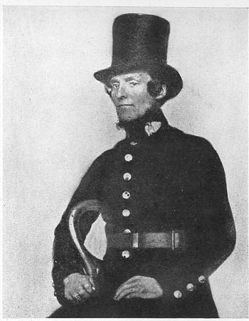
Lesson 19: 1700-1900 Law Enforcement – The Development of the Police with the Bow Street Runners.
Background information: Before the 1700s, the main development with law enforcement was the reduction in community based collective responsibility with an increase in officials employed by the local authorities with the responsibility for dealing with crime and catching criminals. With an even bigger population and towns becoming even more crowded, the government needed to do much more to keep law and order. This period saw a key development with the creation of an official, nationwide police force.. It started with a group called the Bow Street Runners in London, whose success inspired the government to introduce the police in a more formal setting.
STAGE 1: The Bow Street Runners
They were a crime fighting team set up in London in 1748 by a judge called Henry Fielding who worked in Bow Street, London.
They investigated crimes and detected criminals. They became known locally as the Bow Street Runners.
He realised his men needed to be disciplined and trained, to achieve a better reputation with the public.
At first, the Fielding brothers charged a fee for the capture of a criminal just like the Thief Takers who went before them.
They then set up a newspaper called The Hue and Cry which appealed for help and information from the public about crime.
They introduced patrols on horseback to stop highwaymen.
By 1785, The Bow Street Runners were officially paid by the government and they were the first modern detective force.
Why were they successful?
POLICE PRESENCE:
They wanted to deter criminals. Just being present on the streets could do this.
ORGANISATION:
They organised regular foot patrols and horse patrols along all major roads.
PAY
Their men were paid and so more motivated.
INFORMATION
They knew the importance of sharing and collecting information – so could use their office as a meeting place.
STAGE 4: Establishing the police force outside of London 1829 -1856
Improving the police outside London was very slow.
1839 Rural Constabulary Act allowed all rural areas create a force. Only 59 did.
Some had professional, paid police, others still relied on the Parish Constable.
WHY WAS IT SLOW?
Worry about the costs of the police.
It was not yet compulsory in all areas.
London were not quick to share ideas about how it worked.
STAGE 6: Detecting Crime The start of the CID 1842
1842 – A detective branch was set up at Scotland Yard (the headquarters of the Metropolitan Police). They specifically investigated crimes and wore ordinary ‘plain clothes’. It had 16 officers.
By 1878, this was set up as the CID – Criminal Investigation Department. It employed 200 detectives. This increased to 600 detectives in 1883.
However, the public often saw these men as suspicious and even treated them like spies.
1750 | 1760 | 1770 | 1780 | 1790 | 1800 | 1810 | 1820 | 1830 | 1840 | 1850 | 1860 | 1870 | 1880 | 1900
Similarities with law enforcement before 1700:
Parish constables – still dealt with local disorderly behaviour and petty criminals in the smaller towns and villages.
Watchmen – were still responsible for protecting property at night.
Soldiers – could be used by the government when needed to deal with riots or rebellions.
Similarities with modern police force after 1900:
Some officers were paid for the job.
They carried out regular and routine foot patrols.
They had the power to arrest.
STAGE 2 Opposition to an official police force in the early 1800s
FREEDOM
People believed they would not have privacy or freedom with the police watching all the time.
WOULD IT WORK?
People did not believe an organised police force it would reduce crime.
MONEY
It might prove to be too expensive to run.
STAGE 3: London’s 1st Professional Police Force.
Set up in London by Home Secretary Robert Peel in 1829. Peel was inspired by the success of the Bow Street Runners.
Set up by the Metropolitan Police Act.
It became the first uniformed police.
17 districts had their own police ‘division’ with 4 inspectors and 144 constables.
The aim was to deter criminals by being a uniformed presence on the streets. They had far more officers than the Bow Street Runners.
They had a blue uniform so they did not have a negative reputation linked with the army who had a green uniform.
STAGE 5: Setting up an official, national police force.
1856 Police Act meant that ALL areas now had to have a professional police force that was controlled by and inspected by the government.
It also emphasised the ‘detection’ of criminals as well as the ‘deterrence’.
By 1869, National Crime Records were set up.
Telegraph technology could be used to communicate and share information about criminals and crimes.

Slide 23
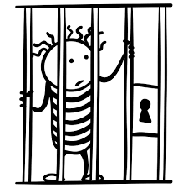
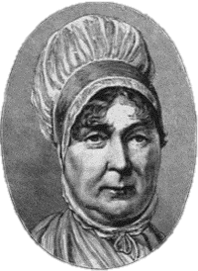
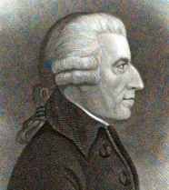
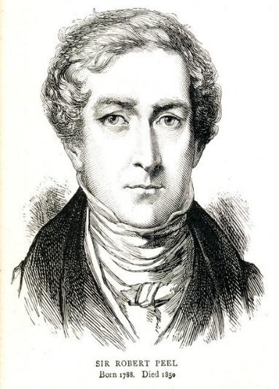
Lesson 20: 1700-1900 Punishments: Prison Reform and humanitarianism.
Background information: As well as the development of a government organised, national police force, this period also saw the development of the prison system in Britain. Again, this was another development by Robert Peel. However, there were other factors that influenced the development of prisons. The Victorians were increasingly worried about the rising crime rate. In this time, prisons became to be seen as the most effective option for criminals now that the Bloody Code. transportation and public executions had come to an end. This era also saw the end of the squalid, cramped and dirty conditions in prisons. It moved to a healthier and more organised system – however there was still an emphasis on hard work and tough conditions.
KEY INDIVIDUALS
Elizabeth Fry
Elizabeth Fry led a campaign to improve women’s prison’s through education, religion, better food and clothing.
She investigated Newgate Prison in 1813. She wrote a shocking report about the treatment of women to the government.
Elizabeth Fry led bible classes in Newgate Prison to encourage reform
In 1817, she set up the Association for the Reformation of Female Prisoners at Newgate Prison.
Her recommendations were brought in by the government after her campaign.
KEY INDIVIDUALS
John Howard
John Howard led a campaign to make sure that prisoners who had finished their time in prison were actually released rather than remain in prison until they could pay their way out.
In 1777, John Howard published his findings of prison life called The State of Prisons in England and Wales. It was hugely influential as it contained accurate evidence to prove change was needed by the government.
John Howard made visits to individual prison leaders around the country to convince them to make all of his changes.
THE LAW
The Gaols Act (1835) made sure that all prisons were inspected.
The Gaol’s Act (1823). Prisoner should be separated into groups such as men, women, children, violent and non-violent.
The Prisons Act (1865) New rules for all prisoners and prison staff.
National Prisons Commission (1877). All prisons brought under government control.
The Prison’s Act (1898). A law which made rehabilitation and reform a priority for the treatment of prisoners.
CHANGING ATTITUDES
Humanitarians such as Fry and Howard influenced the government and public opinion. They believed that humans such be treated fairly and with dignity.
There was an increasing feeling that punishments should now be equal to a crime committed and a varying the time in prison could achieve this.
There was no longer a belief in the Bloody Code.
People believed that prison should not be about sitting around, but working hard to pay back society.
RELIGION
Howard and Fry both believed that prisoners should be given Christian teaching from a prison chaplain, then time in on their own to reflect on their behaviour.
Christian groups pressured the government to make prisons humane.
SOCIAL
Crime rate reported per year had risen from 5,000 to 20,000 BY 1900.
Despite Britain’s wealth, poverty led to an increased crime rate.
POLITICAL
The government wanted a more effective punishment compared with the Bloody Code which ended in 1869.
Robert Peel was a skilled and influential politician. As Home Secretary & Prime Minister he supported changes to prisons.
Humanitarians, Fry and Howard had a huge influence over the government.
TECHNOLOGY
The treadwheel, despite being a harsh punishment, split prisoners into individual cubicles. The power from this was able to pump water through prisons such as Pentonville in London.
Better building techniques allowed prisons to be made more secure & safe.
Better hygiene was possible in prisons due to the development of sanitation and sewage systems in more modern buildings.
ECONOMIC
John Howard disliked prison staff being bribed by prisoners for food, drink and other ‘pleasures’. He wanted an official wage for prison staff. This would make the service more respected and stop the rich receiving better treatment than the poor while in prison.
Britain was economically wealthy due to the Industrial Revolution. The government had money to spend on building new prisons.
POPULATION
The population grew from 10 to 40 million. This led to more criminals and a need for somewhere for them.

Slide 24
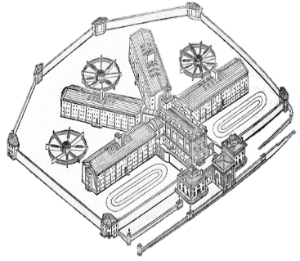
Lesson 21: 1700-1900– Pentonville Prison and the Separate System.
Basic Pentonville Facts
It was built in 1842 and located in London.
It could hold 520 inmates in separate cells.
It had 5 wings with a central base for staff.
Built as a ‘prototype’ – a design to be tried out before other prisons like it were built.
It used a ‘Separate System’. Prisoners were kept apart for as much time as possible. They could be kept in separate cells for up to 23 hours a day.
Between 1840-1880, 90 other prisons were built on its model due to its success and effectiveness.
Background information:
By the 1800s, the prison system was reforming (changing). Before 1700, prisons were dirty & overcrowded with hardened criminals mixing with young petty thieves, women and children. Once in prison, prisoners would have nothing to do but sit around doing nothing. The rich were able to bribe prison officers for luxuries while the poor could not even afford the release fee and so stayed in prison. One prison which became a prototype for others to follow was Pentonville in London. There many differences between Pentonville and previous jails.
The aims of Pentonville Prison
Separate System. Keeping prisoners apart.
Isolation of prisoners to encourage reflection on behaviour.
Separation of women, children, adults and types of criminals.
Hard labour to encourage hard work and rehabilitation.
Strict discipline to reform the character of the prisoner.
Religious teaching to further reflect on behaviour.
Improved health and hygiene to treat prisoners humanely.
Increasingly Strict in 1865
1865 Prisons Act made ALL prisons as strict as Pentonville.
The belief was ‘hard labour, hard fare (food) and hard board (conditions)’
Prisoners were given physically demanding work for up to 12 hours a day.
They were given the same boring/bland food every day.
They had wooden board beds instead of hammocks that prisoners had previously.
The Silent System = prisoners expected to be silent at all times. Breaking this would result in further corporal punishment such as whipping.
Prisoner Conditions
Life was highly disciplined.
Prisoners were isolated from each other.
Prisoners were made to work inside their cells completing very boring, repetitive work such as picking apart old rope or weaving.
There were punishments inside the prison such as turning the ‘crank’ or the ‘treadwheel’.
Prisoners were allowed out in an exercise yard but would have to wear face masks to stop them speaking to prisoners.
Prisoners would also receive religious teachings from a prison chaplain but even in the chapel they would be seated in separate booths.
Technology & Health
The prison had heating and it was mechanically ventilated for extra air in the summer.
New technology such as piped water went into each cell which meant prisoners didn’t have to leave the cell. There was a small wash basin and flushing toilet in each cell.
Why the Separate System? 5 ‘R’s
1. REFLECTION: Prisoners would have time to reflect and make improvements in behaviour.
2. RELIGION: Offer time for prisoners to think about daily religious teachings on their own.
3. RELATIONSHIPS: Keep prisoners away from the influence of other criminals.
4. RETRIBUTION: The punishment was harsh enough to make the criminal ‘pay’ for what they had done.
5. DETERRENT: The punishment would act as a deterrent to others and the prisoners.
Consequences of the Separate System:
Solitary conditions meant prisoners often suffered from mental illnesses including psychosis (hallucinations that appear real) and depression.
There was a high rate of suicide.
The Cells
Each cell was just 4m x 2m.
Small high window for some natural daylight.
Cell walls were thick so prisoners could not communicate with each other.

Slide 25
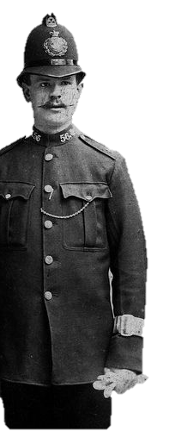
Lesson 22: 1700-1900 The influence of Robert Peel on the Police and Penal (punishment) System
Background information:
Many historians will argue that the actions of Robert Peel were key to reforms in the police and prison service in the 1800s. Robert Peel was British Prime Minister and before that the Home Secretary. The Home Secretary is the minister in charge of law and order. Use this fact sheet to get a closer look at the impact he had and why he was such a great influence.
ROBERT PEEL BASIC FACTS:
Home Secretary:1822-1830
Prime Minister: 1834-1835
Prime Minister: 1841-46
Known as: ‘The father of modern policing’
Responsible for: Setting up the Metropolitan Police Force in London. This modelled other forces around the country.
Influenced: A wide range of laws which changed punishment and law enforcement.
PEEL’S STRENGTHS
He had a open mind to new ideas.
He listened to the views of campaigners such as Elizabeth Fry and John Howard.
He was a skilful politician when making sure laws were voted for and passed – despite tough opposition.
PEEL IN THE 1820s
Peel wanted penal reforms to rehabilitate criminals rather than just focus on the harsh punishment itself.
He reduced the number of crimes punishable by death by 100.
He made sure minor crimes such as poaching were punished more proportionally.
He reformed prisons.
He organised the legal system by making sure criminals received the same punishments for the same crime.
KEY LAW: PEEL’S 1823 GAOLS ACT
Ensured regular visits from prison chaplains Ensured a wage was paid to prison staff to prevent bribery and increase professionalism. Made sure that female prisoners were to be watched by female wardens.
Made sure that prisoners were not held in chains or irons.
HOWEVER - At this time there were no inspectors to check this was happening.
CRITICISMS OF THE METROPOLITAN POLICE
At first there was a hostile attitude from the public and the press.
Newspaper cartoons mocked police officers for being poorly trained, from dubious backgrounds and for not behaving as they should on duty such as being drunk or taking bribes.
2,800 officers were signed up but only 600 stayed for a year or more.
The public worried about:
Public worried about the police being too much like the army.
Their freedoms being threatened.
The cost of the police from increasing taxes.
HOW ROBERT PEEL TRIED TO REDUCE OPPOSITION TO THE POLICE.
9 clear rules/guidelines were set up to all new police recruits. (These still remain today). These rules were made to reassure the public.
For example:
Police need to form a positive relationship with the public to be effective.
Police must be objective and professional.
Policing must focus on keeping law and order.
Police should be positive role models, fit and healthy.
Police will not overstep their authority.
Force will be the last resort of a police officer and officers will not be armed with weapons. Officers would carry a truncheon, handcuffs and a wooden rattle.
PEEL FORMED THE MET. POLICE IN 1829
He had been thinking about a change to the police in 1822 when he set up a parliamentary committee to look into it.
In 1826 there was an economic downturn which increased poverty. There was a crime wave, rioting and the army had to be brought in. This was proof that a police force were needed.
Peel saw that wealthier parts of London had good numbers of watchmen while poorer parts lacked watchmen and constables. He wanted to make this more equal and fair.
The first Metropolitan Police officers were appointed in September, 1829.
After 1829, the police gained their nickname as either the ‘bobbies’ (after Robert) or ‘Peelers’. That is why we still use the term ‘bobby’ today in relation to the police.

Slide 26
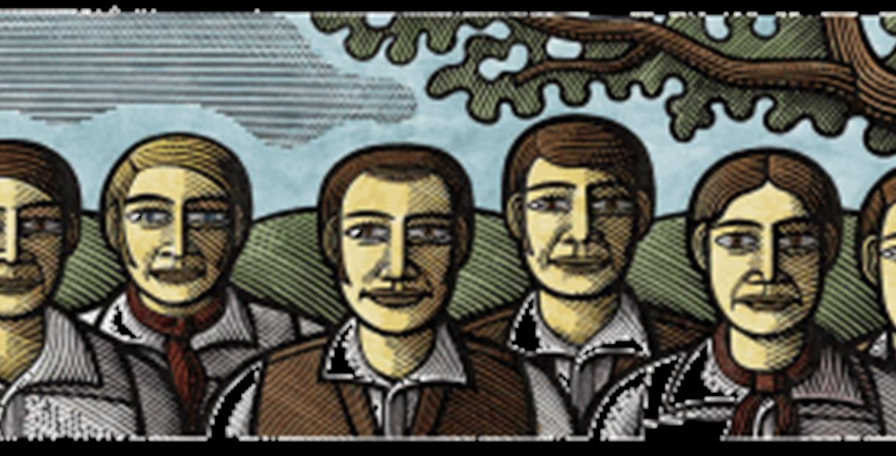
Lesson 23: 1700-1900 – The treatment of the Tolpuddle Martyrs 1830s.
8. Why did the government change their mind?
Four years later, in 1838, the government pardoned and released the men who were now known as the Tolpuddle Martyrs. The men returned home to a ‘hero’s welcome’.
1. The historical context – what was happening at the time?
A revolution in France in 1789, had briefly overthrown the monarchy – thousands of nobility/royalty were executed. Obviously, this made the British government feel very vulnerable and fearful of the poorer ‘working classes’.
Huge industrialisation and urbanisation meant many workers lived in poor conditions with poor wages. Many wanted change, including the right to vote and to go on strike. They started to form trade unions. The government were worried that this could give the workers too much power.
4. Their Punishment
George Loveless and the other 5 were sentenced to 7 years transportation to Australia.
Transportation was the most severe punishment the judge could give for this crime. The conditions on these ships and the forced labour after the journey was extremely harsh.
Why was this punishment given?
It was a way for the authorities to deter others from forming or joining a trade union and stop workers from demanding higher pay. Trade Union members were treated at criminals.
9. What does this example tell us about government control of crime and punishment?
That governments could change and manipulate laws in reaction to changing attitudes of the time. In this case, they wanted to protect business owners and stop workers from demanding higher wages.
2. The Background
In February 1834, in the village of Tolpuddle, a farm labourer called George Loveless was arrested for a made up crime – just because he and his men had promised to support a trade union. It seemed the authorities needed an excuse to arrest them for something, even though they did not threaten a strike or violence.
5. How did the public find out about this punishment?
The Old Crown Court in Dorchester was one of the earliest to have a section for the local press. This meant news of the conviction spread across the country quickly.
Mass protests were organised in support of the men. A demonstration was held in London where around 100,000 people and a petition with 200,000 signatures was presented to parliament.
3. Why were they really arrested?
The real reason for their arrest was to stop their political activities. The men had promised other workers in the area that they would do what they could to protect wages.
They had also formed a group they called a ‘friendly society’. This was actually an early version of a trade union.
They wanted to protest about their wages. They were only getting 6 shillings per week as a farm labourer, rather than the average wage of 10 shillings of the time in other jobs.
Key Terms:
Martyr – a person who suffers for their belief and who is often admired for it.
Trade Union – An organisation that represents workers to protect their rights for fair working conditions and pay.
Tolpuddle – A village in Dorset (SW England)
Home Secretary – The government minister responsible for law and order.
6. How did the government react to this?
The Home Secretary, Lord Melbourne refused to accept the petition and went ahead with the transportation to Australia.
7. What happened next?
Rather than giving up, other trade unions supported the families of the men with money.
Notes:
Designed to be a back to back homework sheet to go with the next slide.

Slide 27
Explain one similarity/difference…[4] | Explain why… [12] | How far do you agree… [16]
Explain one way in which conditions in prisons in the 19th century were different in the 17th century. [4] Explain one way in which policing in the 19th century was similar in the 16th century. [4] Explain one way in which policing in the 19th century was different in the 1600s. [4] Explain one way in which smuggling in the 16th century was similar to smuggling in the 19th century. [4] Explain one way in which smuggling in the 16th century was different to smuggling in the 19th century. [4] Explain one way in which law enforcement in the Medieval period was different to law enforcement in the period 1700-1900. [4] Explain one way in which law enforcement in the Medieval period was similar to law enforcement in the period 1700-1900. [4] | Explain why the problem of highway robbery increased in the period 1700 – 1900. You may use the following information in your answer: Increased wealth Improved transport You must also use information of your own. [12] Explain why the Bloody Code came to an end by the late 1800s. You may use the following information in your answer: Public Executions Humanitarianism You must also use information of your own. [12] Explain why transportation was used as a punishment in the period 1600 – 1850. You may use the following information in your answer: Colonies abroad Hard Labour You must also use information of your own. [12] Explain why there were changes in the prison system in the period 1700-1900. You may use the following information in your answer: John Howard Hard labour You must also use information of your own. [12] Explain why the crime of smuggling increased after 1700. You may use the following information in your answer: The Hawkhurst Gang The growth of the British Empire You must also use information of your own. [12] | ‘Robert Peel was the most important reason for prison reform in the period 1800-1900’. How far do you agree? Explain your answer. You may use the following information in your answer: Gaols Act 1823 Humanitarianism You must also use information of your own. [16] ‘In the period 1700-1900, the main aim of punishment was as a deterrent’. How far do you agree? Explain your answer. You may use the following information in your answer: Pentonville Prison Tolpuddle Maryrs You must also use information of your own. [16] ‘The role of reformers was the main reason why prison conditions improved in the 19th century. How far do you agree? Explain your answer. You may use the following information in your answer: Elizabeth Fry Technology You must also use information of your own. [16] ‘The use of public execution remained an important feature of the punishment system in the years 1500-1900’. How far do you agree? Explain your answer. You may use the following in your answer: The Gunpowder Plot Transportation You must also use information of your own. [16]

Slide 28
Key Terms & people | 1700-1900
Crimes & Laws
Law Enforcement
Punishments
What caused change in the period c.1700 – c.1900? | Explain
Key individuals
Monarchy
Politics/government
Religion
Society/attitudes
Economy/trade
Travel/immigration
Growth of towns & population
Key differences with the period 1500-1700 | Key similarities with the period 1500-1700
Crimes and Laws | Crimes and Laws
Law Enforcement | Law Enforcement
Punishment | Punishment

Slide 29
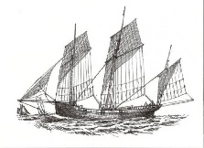
Lesson 24: 1900-Present day – Types of Crime.
Background information: It may seem that between 1900 to the present day, more acts have been made illegal and become crimes. However, you need to think about the crime first before judging it as ‘new’. Crimes between 1900 to the present day may be ‘old’ crimes just carried out using different methods, for example with the invention of the internet or the motor car. Some may be classed as crimes because before 1900 they were not seen as illegal & attitudes towards certain behaviours changed, for example drug taking, homophobic or race crime.
Driving Offences (social crime)
Definition
Driving offences can include speeding, drink driving, driving without insurance or theft of a vehicle.
Old Crime
Horse drawn coaches were used from the 1700s. Highway Robbery was a form of transport theft in the 1800s.
New Crime
Cars were cheaper, faster, more dangerous and more widely used after the 1930s. There was more opportunity for speeding, drink driving and driving without insurance.
What caused a change in the law?
Car have become more dangerous. Even by 1934, 7,343 people had been killed on the roads. Drink driving used to be socially accepted until the 1980s when a government campaign meant attitudes changed.
The law
Driving a horse drawn coach while drunk was first illegal in 1872. It then became illegal to drive while drunk in 1925. In 1967, another new law set a maximum alcohol limit in order to drive. A driving test had to be passed after 1935.
Drug Taking & dealing (social crime)
Definition
Dealing/taking medication/drugs which have been banned.
A different attitude towards drugs before the 1900s.
Cocaine were first used as a medicine to stop pain. Opium has been openly used for pain relief around the world for hundreds of years. It was once described in the 1800s as ‘God’s own medicine’ and common with the rich and famous.
What caused a change in the law?
The government banned drugs such as cocaine, heroin, opium and cannabis being taken by soldiers during the World Wars. They were worried about their effectiveness in battle. New scientific methods of producing ‘chemical’ drugs have led to further laws against LSD, speed and ecstasy .
The law
Drugs first started to be made illegal in 1971 with the Misuse of Drugs Act. As new drugs are developed, further laws have been needed.
People-trafficking/slavery
Definition
People from other countries being illegally brought to the UK and forced to work. Women often forced into prostitution.
New Crime.
This is a new crime with new laws against it. Better transport, communication and technology has allowed more people trafficking. Despite high levels of security, it is easy to bring people in due to the variety of transport now available.
What caused a change in the law?
Public awareness of this crime has led to increased pressure on the government to deal with it.
Smuggling
Definition
Illegally importing goods, substances without paying government import duty.
Old Crime
Smuggling has happened for hundreds of years, since trading abroad started in the 1400s. Historically, goods such as brandy, cloth or tea were illegally brought in. Many people did not report this as a crime as they benefitted from the cheaper prices.
New Crime
Recent types of smuggling such as cheap alcohol and cigarettes have been seen as less serious. Methods of smuggling stayed the same.
Terrorism
Definition
The use of violence to bring about political or religious change.
Old Crime.
Guy Fawkes used terrorist methods to try and blow up parliament in 1605 to bring about political and religious change. It just wasn’t called ‘terrorism’ then.
New Crime
The media has made more recent terrorism wider known. For example the IRA bombings in the 1970s, Al-Qaeda and ISIS attacks.
What caused a change in the law?
High profile attacks in England and the USA caused a change in law.
The law:
2000, 2001, 2003, 2006 Terrorism Acts all gave police more powers to arrest suspected terrorists.
Cybercrimes
Definition
This is any crime carried out using the internet or other digital technology.
Old Crime.
Theft, fraud, stealing property, hacking, copyright, making threats.
New Crime
With email and the internet, various crimes were being carried out from the 1990s onwards. The government needed new laws.
The law
Computer Misuse Act (1990) tackled computer hacking.

Slide 30
HOMOPHOBIC CRIME
Definition
An act of violence, prejudice or discrimination against a
homosexual person.
Crime reversed!
Until 1967, homosexuality was illegal in the UK and men could be sent to prison.
What caused its decriminalisation?
Protests in the 1960s onwards in the UK and the USA raised awareness of gay rights. The first gay pride festival in the UK was held in 1972 which made homosexuality more acceptable and helped change attitudes.
The law
The Sexual Offences Act (1967) decriminalised homosexuality for men over the age of 21.
The Criminal Justice Act (2005) made the punishment for homophobia even harsher.
RACE CRIME
Definition
A crime motivated by prejudice against a person’s race.
New definition of a crime
After the Second World War, many people immigrated to Britain to work and help Britain recover from the war. Immigrants came from India, Pakistan, The Caribbean. Some immigrants came to escape discrimination in their own country. E.g. Uganda and Kenya in Africa. As more immigrants settled in Britain, attitudes towards them changed and a growing racism developed in the 1960s.
The Law:
The Race Relations Act 1968. Made it illegal to refuse a job, housing or public service to anyone based on their race or country of origin.
The Race Relations Act 2006: The law also took account discrimination on the basis of religious belief as well as racial background.
DOMESTIC VIOLENCE
Definition
Violence or intimidation between a couple in a relationship.
New definition of a crime
Domestic violence has always existed for both genders but before the 1950s,
it was ignored and accepted by many that violence happened in some relationships and it would be seen as ‘personal and private’ business of the couple rather than something that needed reporting as a crime. Rape within marriage was not seen as a criminal offense as women were expected to accept the dominance of the man.
What changed?
The campaign for women’s votes, the role of women during the wars and the feminist campaigns of the 1960s and 1970s influenced social attitudes towards domestic violence and equality.
The Law:
Domestic Violence Act 1976: Gave the victim of domestic violence the right to ask for an injunction (instructions to stay away from the victim).
Rape in marriage 1991: The law now stated it was possible to prosecute a husband for raping his wife in marriage.
Domestic Violence Act 2014: Controlling or intimidating behaviour towards a partner was made a crime. E.g. stopping access to money, access to phones etc.
ABORTION
Definition
The ending/terminating of a pregnancy before a baby is born.
Crime reversed!
In 1868, a woman could be sent to prison for 3 years if she was known to have had an abortion. Until 1967, it was illegal to terminate a pregnancy (have an abortion) apart from very strict medical reasons. Women turned to dangerous ‘backstreet abortions’ which would be carried out by someone with no medical training using dangerous techniques which led to severe damage to the mother.
What changed?
A growing liberal attitude in the 1960s led to large protests from some who believed the law should be changed. The belief was that by making abortion legal would be safer for women.
The Law:
1967 Abortion Act. Legalised abortion when there was a risk of a child having a severe disability or the mother being at risk from harm.

Slide 31
Lesson 25: 1900-Present Day – Law Enforcement with the development of policing.
Background information:
We have already found out how the police developed in the 1800s into a national police force with rules setting out what was expected of them and the methods which they could use. From the starting point of the Bow Street Runners in 1748, to the creation of the Metropolitan Police in 1829 and then the 1856 Police Act which recommended that all parts of the country had a government led police force; the police developed even more after 1900 to become the main method of law enforcement in the country. You will not be expected to remember all of the many dates and events given to you on this sheet. However, try to remember a few and think more about the impact they will have had.
AT THE START OF THE 1900S
Positives:
Every area in the UK had its own police force.
Most officers were being paid for their work.
A standardised dark blue uniform was used to easily identify the police.
Police were starting to gain the respect of most people.
Negatives:
The 200 separate forces had no central records (details of all crimes committed in the UK.
Police forces rarely shared information with each other or worked together.
Police officers patrolled local areas on foot ‘walking the beat’.
Police only had a whistle to call for help or raise the alarm.
1900: Photographs were being used to identify criminals. Police would display a ‘Rogues Gallery’ of local criminals.
1901: Fingerprinting first used by the Metropolitan Police. A national fingerprint system still keeps a record of every fingerprint and is part of a nationwide central system.
1901: Blood types start to be used to identify victims and criminals.
1909: Bicycles allowed officers to move around a large area and catch criminals quickly.
1920: Women recruited into the police. At first to work with female victims or criminals.
1930s: Police cars now common.
1930s: Two way radios (so an officers could talk with each other) were used in cars.
1937: The Police Phone Box (Dr Who style) to save officers on the beat needing to return to the station to report information.
1937: 999 emergency telephone number started for the Metropolitan Police.
1947 – Police Training College was created to give formal training.
1965: Tear gas allowed to be used by the police to break up riots.
1967: Breathalysers used for the first time to deal with motor crime.
1969: Police two-way radio now attached to the uniform.
1970s: CCTV developed for the first time to monitor public behaviour.
1980: The National Police Computer launched which was able to hold records of 25 million individuals (amazing for the time).
1982: The Neighbourhood Watch scheme. Proof of continued Collective Responsibility.
1988: DNA used to convict a murderer for the first time.
1992: Speed cameras introduced to act as a deterrent and catch speeding cars.
1995: National DNA and fingerprinting databases introduced.
2007: The Neighbourhood Watch became a national network.
THE OVERALL CHANGES DURING THE 1900S:
An increasing use of science and technology to help police methods.
More specific roles given to police officers in separate specialist units.
A greater move towards crime prevention, education and rehabilitation.
The cost of all of these changes increased due to the higher demand of the police service.
AN EMPHASIS ON CRIME PREVENTION:
Every force now employs Crime Prevention Officers (CPOs). They advise local people about preventing crime on issues such as fitting locks and alarms properly.
There is greater emphasis on catching young offenders early to prevent them from continuing with a life involving crime.
The Neighbourhood Watch began in 1982 where members of a community report crime to the police who can then follow it up. In 2007, Neighbourhood Watch became a national network. This still uses the similar idea of collective responsibility for crime.

Slide 32
Lesson 26: 1900-Present Day – Law Enforcement with the specialisation of the police.
Background information:
One key change with law enforcement after 1900 was the increasing specialisation of the police force. The police had started to specialise very early in the 1900s with the creation of the Criminal Investigation Department and the Special Branch. However, due to increasing amounts and types of crime that developed throughout this time, the police have responded by training staff in specialist areas. The cause of this specialisation is often a response to an increase in a particular type of crime. For example, the Bomb Squad were set up in 1971 s a direct response to the IRA terrorist bombings at this time. The Hi-tech Crime Unit was set up in 2001 to tackle the increasing amount of internet crime.
FACTORS WHICH LEAD TO INCREASE THE NUMBER OF SPECIALIST POLICE UNITS
Increase in a specific type of crime. E.g. terrorism, drug dealing, internet fraud.
Media present the crime via radio, TV, newspapers, internet.
Public concern increases and attitudes against the crime change.
The public pressure the government to make harsher laws and methods of law enforcement to prevent the crime.
Government respond with new laws.
The police develop a specialist unit to enforce this law.
Special Branch (1883)
Aim:
To tackle threats to national security & terrorism. A responsibility to protect the royal family & VIPs from danger.
Specialism:
Trained to work with the security forces such as MI5 and
MI6 to prevent terrorist attacks. Under cover officers
use specialist surveillance & ‘intelligence’ technology.
Similarity/difference?
They were first created in 1883 in London to protect the movement of the royal family and other VIPs. Now, every part of the country has its own Special Branch.
The Fraud Squad (1946)
Aim:
To tackle crime in business and
finance and money.
Specialism:
Officers have expert knowledge in
finance, business, internet fraud and art theft.
Similarity/difference?
A new type of squad set up in reaction to the varied number of fraud cases.
Dog Handling Units (1946)
Aim: To accompany officers as they patrolled the streets as a deterrent and a way to catch criminals.
Specialism:
Dogs handlers and their dogs used :
To sniff out illegal drugs and find explosives
To track and catch criminals or search and rescue people in trouble.
To act as a deterrent and to strengthen police presence at major events.
Similarity/difference?
Remember that the Metropolitan Police aimed to use sniffer dogs to try and catch Jack the Ripper (even though this failed). The first units were set up by the Met. Police in 1946 and by 1950 most forces used dogs.
EXAMPLES OF SPECIALIST UNITS
National Crime Agency & Drug Units (1971)
Aim:
To reduce the use, transportation, making and dealing of illegal drugs.
Specialism:
They have the power to carry out drugs raids, monitor drugs gangs and dealers. They are also trained to prevent further spread of drug use through education and rehabilitation.
Similarity/difference?
It was only created by the 1971 Misuse of Drugs Act which made drugs illegal like heroin, cocaine and cannabis. A unit was needed to enforce this new law. All police forces in the UK have specialist drug units.
Police Community Support Officer (2002)
Aim:
Set up by the Met. Police at first to reduce local, anti-social behaviour. Specialism: Trained to deal with local communities. Increased time ‘walking the beat’ on foot to be visible to the public. They only have a limited responsibility to arrest individuals but can confiscate alcohol, drugs and items seen as weapons.
Similarity/difference?
Police are visible in uniform ‘walking the beat’ as a deterrent, similar to the aim of the police when they were created in 1829.

Slide 33
Lesson 27: 1900-Present Day: Punishments & the abolition of the death penalty in 1969
Background information: Hanging as a capital punishment was used since Anglo-Saxon times. It peaked in the 1700s with the idea of the Bloody Code. Since the 1800s, due to alternative punishments its use declined and then by the 1830s, murder and treason were the only crime punished with the death penalty. By 1869, public hangings were stopped and the few criminals punished in this way were hanged privately in prisons. By 1957, the number of hangings reduced to roughly 4 people per year. So why was the death penalty abolished by 1969? The factors below have been categorised for you, but think about how they will relate to each other. Can there be one overall factor as the most significant to promote this change?
FACTOR ONE
POLITICAL - Roy Jenkins
Although there was some politicians who wanted to keep the death penalty, the Home Secretary, Roy Jenkins influenced enough MPs to first vote in a law against it in 1956.
MPs will have listened to the attitudes of the people they represented in order to decide to abolish the death penalty.
FACTOR TWO
POLITICAL – The Declaration of Human Rights.
In 1948, after the atrocities of the Nazis in the Second World War, the United Nations (a group of leading countries) issued its Declaration of Human Rights. It said ‘Everyone should have the right to life, liberty and security of person’. It also said ‘No one shall be subjected to torture or to cruel inhumane punishment’.
This led the public and government to believe that the death penalty went against the Human Rights Declaration and so must be abolished.
FACTOR THREE
POLITICAL/SOCIAL ATTITUDE - The Impact of World War Two
People were more aware of bloodshed, death and the horrors of war such as the Holocaust. Attitudes changed to believe that execution was barbaric and un-Christian.
After finding out how the Nazis treated the Jews through the media, it seemed wrong to continue with the death penalty as people linked executions with Hitler.
FACTOR FOUR
SCIENCE – Human development
More scientists and psychologists believed that children in particular should not be punished in the same way as adults as their ability to understand the difference between right and wrong was not yet developed.
As a response, the government ended hanging of children under 16 in 1908, then under 18 in 1933. It also introduced an ‘age of criminal responsibility’ of 10 years old in 1963.
FACTOR EIGHT
SOCIETY High profile cases of wrongly convicted criminals.
Timothy Evans was hanged in 1950
Timothy Evans lived in the same house as a serial killer called John Christy. John Christy murdered Timothy Evan’s wife. In confusion and a fit of guilt, Timothy Evans admitted to killing his wife. Timothy Evans was given the death penalty despite being innocent. The police later admitted to knowing about the behaviour of John Christie.
Derek Bentley was hanged in 1950
The case of Derek Bentley also caused a huge public pressure for change as many saw him as innocent of murder. The public outcry of his execution was a clear contribution to the arguments against the death penalty. (See the Derek Bentley Case Study on the next page)
Ruth Ellis was hanged in 1956
Ruth Ellis was guilty of shooting her ‘lover’ in a ‘crime of passion’. It was known that this was an abusive relationship in which she was often beaten. Nobody questioned that she was guilty, but there was a huge amount of public sympathy for her in the newspapers knowing that she was trying to defend herself from her husband.
Factors to explain the end of the death penalty.
FACTOR SIX
MEDIA - Newspapers, radio and TV.
Many attitudes changed due to the sensationalised stories about the death penalty in local and national newspapers. This increased the public awareness of the punishment which had so far been hidden.
The horrors of the Second World War were shown in newspapers and the public linked death with the Nazis – not something which should happen in Britain.
This was especially true when the newspapers made huge stories out of individuals who were executed when they were innocent and it created public sympathy.
FACTOR FIVE
SOCIAL ATTITUDES – 1960s Liberal ideas.
During the 1960s, attitudes in society become more ‘liberal’. This means that people were willing to be fairer and have a more open mind about all aspects of life.
The media and popular culture inspired this more liberal way of thinking. This liberal attitude from the public, put pressure on the government to make changes to punishments.
FACTOR SEVEN
RELIGION - Christian attitudes
More people believed that the death penalty was not Christian and was unmoral.
Christian groups argued for criminals to be reforms and rehabilitated rather than punished using a form of deterrent.
Key Dates
1908: Children's Act – Ends the hanging of children under 16.
1922: Infanticide Act – mothers who kill newly born babies will no longer have the death penalty due to the effects of hormones after birth.
1933: Young Person’s Act – Hanging of under 18s ends.
1956: Homicide Act – Limits the death sentence to certain types of murder.
1969: Murder Act – Death Penalty ends for all crimes apart from treason
1999 – End of the death penalty for any crime.

Slide 34
Lesson 28: 1900-Present Day – Case Study of Derek Bentley. ‘Let him have it, Chris’.
Background information: One case in particular helped change public opinion about the use of the death penalty. Derek Bentley was charged with killing a police officer and was executed by hanging for this crime in January 1953. The newspapers at the time in particular helped form public opinion about the case, which in turn led to angry scenes outside the prison where Bentley was hanged. This case certainly played a significant role in influencing the government to abolish the death penalty in 1969. Below are the events that led to his hanging – think why it was so controversial at the time.
ONE:
Derek Bentley was 18 and had severe learning difficulties.
He had epilepsy and doctors proved he had a mental age of 10.
He struggled to keep a job and make friends. His family had a history of crime.
TWO:
In 1952, Bentley, with a 16 year old friend, Christopher Craig, burgled a warehouse in London. Christopher Craig had a gun and he gave Bentley a knife to carry.
The police arrived while Bentley & Craig were on the roof. DS Fairfax climbed up & captured Bentley.
THREE:
DS Fairfax asked Craig to hand over the gun. Bentley apparently then shouted, ‘Let him have it, Chris’. Craig fired, injuring the Fairfax.
Bentley did not use his knife and made no attempt to escape from DS Fairfax.
More officers climbed onto the roof. PC Sidney Miles was then shot by Craig in the head and killed. Craig then jumped from the roof, fell and fractured his spine.
FOUR:
Bentley & Craig were charged with murder under a law called ‘Joint Enterprise’. Craig was under 18 and so too young to be given the death penalty.
Bentley faced death penalty, despite a doctor confirming he had a mental age of only 10.
Their lawyer argued that Craig meant hand over the gun not shoot the police officer.
NINE:
Bentley was finally ‘pardoned’ in 1998. The Court of Appeal ruled that the punishment was unfair and that the judge had put pressure on the jury to find Bentley guilty.
EIGHT:
This and other such as Ruth Ellis and Timothy Evans were seen by the public and press as undeserving victims of the death penalty.
All three cases led to the abolition of the Death Penalty in 1965.
Songs, films and books were published about the injustice to pressure the government more.
SEVEN:
There were angry scenes outside the prison where the hanging took place.
5,000 protestors chanted ‘murder!’.
The newspapers all criticised the judge and Home Secretary which led to even more public outcry.
Some at the time argued that the judge was trying to make an example of Bentley to other young people who may commit a crime.
SIX:
There was public outcry.
200 MPs signed a petition asking the Home Secretary to cancel the execution. This had already happened in over 50% of the cases they had reviewed.
The Home Secretary refused, and on 28th January, 1953 Bentley was hanged.
FIVE:
Despite not firing the shot that killed PC Sidney Miles, Bentley was found guilty of murder as it was an act of ‘Joint Enterprise’.
He was sentenced to death by the judge - despite the jury asking for a less harsh sentence.
Bentley’s lawyer appealed for mercy but was also turned down.
Craig was imprisoned and not released until 1963
Influence of the Derek Bentley case.
The role of the press, songs and films strongly influenced critical public opinion about the death penalty.
The controversy of the case started huge debates around the country about the use of the death penalty. It increased the awareness of it and influenced the government to abolish hanging.
It led to a new law, the 1957 Homicide Act. This introduced rules for ‘diminished responsibility’. This was for those people who were not in full control of their actions due to an illness or disability.
Reasons why the case was controversial:
The words ‘Let him have it, Chris’ have two different meanings. The prosecution argued that Bentley instructed Craig to shoot the police, the defence argued that Bentley was instructing Craig to give up his gun.
Bentley did not shoot PC Sidney Miles. It was only because of the law stating that he was acting in ‘Joint Enterprise’ that he was found guilty of murder.
Bentley had a mental age of 10 with severe learning difficulties. Doctors confirmed this at the trial. However, he was still given a punishment which was for an adult.
There were riots and 4 police officers were shot in 1952. Many believed the Judge and the Home Secretary wanted to hang Bentley as an harsh example to others to deter this behaviour.

Slide 35
Lesson 29: 1900-Present Day – Prison Reforms (changes).
Background information: When we last looked at the use of prisons as a punishment, prisons were still very harsh with their disciplined treatment of prisoners. For example with hard labour, the separate system and the silent system in Pentonville Prison in particular. However, pressure from Humanitarian thinkers such as Elizabeth Fry and John Howard, had led Robert Peel to make prisons healthier and more dignified for prisoners. There was still the idea of a deterrent by making prison life tough. However, there was a new theory of prisoner reform and rehabilitation, especially with the use of religious teachings. Let’s look at how the prison system developed and specialised for a wider group of social groups after 1900 to the present day.
1902: The Young
‘BORSTALS’ were created for young people. They were often based in old army barracks and life was highly disciplined.
They promoted hard work, rehabilitation and reform to prevent young people committing crime when they were older.
1922 Prison Reform Act
Solitary confinement abolished. Prisoners could interact with other prisoners at set times.
Education for prisoners in skills to be used after their release.
1948: The Criminal Justice Act
Abolished hard labour and corporal punishments.
Set out a national set of rules for prisons.
Encouraged different types of prisons for different groups of prisoners.
Why did the number of prisoners increase after the 1950s?
The government want to be seen as tougher on crime so increased the time given to prisoners in jail.
New types of crime have been defined which were not crimes before the 1950s. – E.g. sexual crimes, drugs crimes, internet related crimes.
The population of the UK has also increased dramatically in recent years.
2014: Education
In 2014, OFSTED judged over half of prisons to be ‘inadequate’ for education with 1 in 5 prisoners have severe issues with basic reading and writing.
1900 | 1910 | 1920 | 1930 | 1940 | 1950 | 1960 | 1970 | 1980 | 1990 | 2000 | Present
1900: Mentally ill
Prisoners moved to separate prisons. E.g. Broadmoor Hospital London.
1907: Probation
Probation is the time after a prisoner has been released. Probation officers checked on these prisoners in this time. This is meant to deter further crime after the punishment.
1933: Open Prisons
Prepared prisoners for life after prison. The first Open Prison in Wakefield, Yorkshire. Prisoners allowed out on day release to work and then expected to return in the evening.
1967: Parole
Prisoners allowed to apply for an early release called ‘parole’ for good behaviour in prison.
1972: Community Service
Introduced for the first time for less serious crimes to prevent a prison sentence.
1990: Electronic Tagging
Introduced for prisoners released on parole.
Prison Population:
The number of people in prison has doubled between 1993 and 2015.
THE MAIN CHANGES BETWEEN 1900-PRESENT
MONEY: Prisons are overcrowded due to less money from the government to build new prisons. The public becoming critical of the cost of keeping a prisoner which is £40,000 per year. Fewer educational or work related opportunities for prisoners due to cuts.
ATTITUDES: Courts believe that non-custodial sentences are better as they focus on rehabilitation and help reform the offender. Some public and media attitudes disagree.
PUBLIC ATTITUDES: Modern prisons have been criticised more for being less harsh on prisoners and have been described as a ‘Holiday Camp’ by some due to the improved conditions for prisoners.
INCREASED CRIME: The number of crimes committed in prisons such as assault & drug usage risen.
AIM AND PURPOSE OF PRISON: The aim of a prison now is to stop a prisoner from re-offending by using education, teaching skills and a job like environment. It is less of a deterrent.
WOMEN: A rise in the percentage of women in prisons to 6% of all prisoners in the UK.
TYPES OF PRISONS: Different prisons for an even wider type of criminal. E.g. ‘extreme’, ‘high security’ prisons and ‘open prisons’ for less violent prisoners who are not confined to cells.
1902: Hard labour abolished.
The treadwheel and crank banned.
FACTORS INFLUENCING A CHANGE IN PRISONS
1. Changing attitudes
The belief that criminals can rehabilitate and reform to join society prison without committing another crime. Educating prisoners with useful practical skills, reading and writing while in prison could help this.
2. Role of the government
The government responded to public worries about crime so made further changes to look ‘tough on crime’.
3. Science and technology.
New technological developments to monitor prisoners more carefully were invented and so used as alternatives to a prison sentence or to make prisons even more secure.

Slide 36
Lesson 30: 1900-Present Day – The punishment of Young People
EXAMPLE OF HOW YOUNG PEOPLE WERE TREATED BEFORE 1900
Example: Edward Andrews (age 15)
Year: 1854
Crime: Minor theft
Punishment: Sent to prison and put in solitary confinement. Was forced to use the ‘crank’. He refused and soaked in cold water put in a straight jacket and fed only bread and water every day until he used it.
Outcome: Hung himself after 2 months.
Background information:
A major change in punishment since the 1900s has been the punishment of young people. Before 1900, children were treated no differently to adults. Various factors then led to a change in the attitude and treatment of teenage offenders. There has been a growing belief that if criminal behaviour is reformed early, it will prevent crime in the future. Rather than punishments being solely as a deterrent, the punishment of young people has developed towards reform, rehabilitation, education and crime prevention. In some cases this has led to criticism that the treatment of young criminals is now too lenient.
CHANGES AFTER 1900
Borstals
MAIN CHANGE: Younger/teenage boys taken into to BORSTALS.
DESCRIPTION:
A very strict routine where inmates took part in jobs, education programmes and military style physical exercises.
Boys were released when staff believed they had changed.
AIM :
To keep young boys away from older, experienced criminals.
To emphasise education and reform NOT punishment although the conditions were tough.
REASON FOR CHANGE: The belief in society that young people were ripe for change and could rehabilitate resulting in no further crime.
SUCCESS IN 1930s:
The number of boys who reoffended was low, about 30%.
SUCCESS BY 1980S:
The number of boys reoffending was higher, about 60%
ABOLISHED:
Borstals abolished and changed to Youth Custody Centres in 1982 after criticism of the military style lifestyle they had to live.
CHANGES IN THE 1940s
Criminal Justice Act 1948
MAIN CHANGE: This law was created by the Labour government after the Second World War. The Labour Party wanted the welfare of young offenders to be improved.
Borstals still used but for fewer, more serious cases.
Youth Detention Centres introduced with a less strict routine compared to borstals. For those who committed less serious crimes.
Attendance Centres for young people who had committed less serious crimes. Attended at the weekends when most crimes were likely to be committed. Would have education and skills sessions. Also drug and alcohol treatment sessions.
CHANGES IN THE 1960s
Children and Young Persons Act 1969
MAIN CHANGE: Further protection of young offenders with a focus on preventing young offenders ending up in prison. The law created by the Labour Party and was hugely influenced by the controversy of the Derek Bentley case.
Specific courts called Juvenile Courts set up with a less intimidating environment compared with adult courts.
Age of criminal responsibility raised to 10.
A big focus on preventing prison sentences and using non custodial (non-prison) sentences, using probation officers and social workers to help young people away from prison
THE PRESENT DAY
CUSTODIAL SENTENCES - Time in prison.
Youth Offenders Institutions (prisons for young people) have been used separately to prisons since 1988 but courts are keen to keep young people away from prisons unless a crime is severe.
YOI remain a deterrent but have been criticised for being too lenient.
Problems with the behaviour of young people have been experienced in YOI such as violent attacks on staff, other prisoners and drug taking.
The rate of success to rehabilitate young people in youth prisons has dropped as a result.
NON-CUSTODIAL SENTENCES – Alternatives to time in prison
School and youth centre talks by the police to prevent crime before it happens.
Fines for parents who cannot control the behaviour of their children.
Electronic tagging to monitor the movement of problem youth offenders.
Community Service for minor offences are ordered to do supervised work.
Restorative Justice The criminal is told to meet the victim of the crime to talk about its impact.
Drug and alcohol treatment programmes Criminals with addiction problems that have caused a crime (such as theft) are offered treatment.
Anti-Social Behaviour Order (ASBO) A courts places a restriction on a youth offender. E.g. what they can do, where they can go.

Slide 37
Lesson 31: 1900-Present Day – Conscientious Objectors in WW1 and WW2.
KEY TERM:
Conscription – it was compulsory to join the army.
Conscientious Objector – a person whose belief about war causes them to refuse to fight.
Absolutist – a person who refused to support war in any way, even if not fighting.
Pacifist – the belief that violence in all ways is wrong.
Alternativist – refused to carry a weapon but would support the war in other ways. These men might be stretcher bearers on the front line and the job was still dangerous.
Background information:
A key example of how public attitudes and government laws have influenced a new crime was the punishment of men who for various reasons, refused to fight in the First and Second World War. So why did men refuse to fight, what was the law against this, how were they treated by the public and media and what was their punishment?
WHAT CHANGED? A NEW LAW.
The Military Service Act 1916 – Men were conscripted into the army for the first time ever in Britain. It was now illegal – against the law to avoid taking part in war.
WHO HAD TO JOIN?
March 1916 – all unmarried men aged 18-41
May 1916 – married men now included and age raised to 51.
The First World War (1914-39)
Some men refused to fight as their ‘conscience’ (their personal feelings/opinions) would not allow them.
The reasons for not fighting:
Religious beliefs against war.
Political reasons against war.
Ethical reasons against war.
COULD MEN OBJECT TO JOINING THE ARMY?
The Military Services Act included a section called the CONSCIENCE CLAUSE which allowed men to ask not to join because of their feelings towards war.
16,500 men made this request.
A judge would decide a case was genuine in a TRIBUNAL
WHY WERE THE JUDGES AND TRIALS NOT FAIR?
Held locally and could sometimes make very personal judgements on people they knew.
The judging panel was made up of local people so not all decisions were equal across the country.
The judging panel were often far to old and did not understand the attitude of the younger men not to fight.
THE TREATMENT OF Cos in the SECOND WORLD WAR
Government attitudes relaxed by WW2 - It would be hypocritical to punish COs in a brutal way while fighting against the Nazis who were brutally treating groups such as the Jews.
COs offered alternative work to help the war.
Prison was now a last resort and not used as a deterrent.
Men who actively oppose the war could still end up in court. They were put on trial but given light punishments.
WHAT WERE THE ATTITUDES TOWARDS Cos?
The government propaganda and newspapers made COs out to be:
Unmanly and feminine if they did not do their ‘man’s duty’.
Cowards, traitors & unpatriotic.
That Cos were lazy and shirking their responsibility.
Some Cos were ignored by their own family and neighbours or received hate mail in the post.
WHY WERE Cos TREATED SO HARSHLY?
The government needed soldiers as many soldiers were being killed.
They needed to prevent ‘pacifist’ ideas spreading and recruit many more men.
The government wanted to avoid protests and resistance during the war time.
The harsh punishments would be a deterrent to any men wanting to refuse.
HOW WERE Cos TREATED?
Many absolutists were imprisoned. E.g. 1,000 prisoners jailed in Dartmoor and made to work in a local granite quarry.
Many absolutists were also put in solitary confinement to stop them mixing with other prisoners?
Some Cos were sent to France anyway, and told to fight. If they refused they were taken to a military court.
Some military courts punished Cos with death.
The Prime Minister then found out about this and reduced the punishment to 10 years in prison.
PUBLIC ATTITUDE BY WW2
Still verbally abused in public, loss of jobs or even attacked because of their views
Attacked by the media and press who showed them as cowards, lazy, unpatriotic. This influenced public attitudes.

Slide 38
Explain one similarity/difference…[4] | Explain why… [12] | How far do you agree… [16]
Explain one way in which conditions in prisons were different in the mid 19th century to conditions in the late 20th century. [4] Explain one way in which law enforcement in the medieval (c.1000 – c.1500) period was different from law enforcement during the modern period (c. 1900- Present day). [4] Explain one way in which law enforcement in the medieval (c.1000 – c.1500) period was similar from law enforcement during the modern period (c. 1900- Present day). [4] Explain one way in which smuggling during the 18th century (1700s) was similar to smuggling during the modern period (c. 1900- Present day). [4] Explain one way in which smuggling during the 18th century (1700s) was different to smuggling during the modern period (c. 1900- Present day). [4] Explain one way in which the treatment of conscientious objectors during the First World War was different to their treatment in the Second World War. [4] | Explain why there were changes in criminal activity in the years 1900-2000. You may use the following information in your answer: Transport Technology You must also use information of your own. [12] Explain why new crimes were defined in the years 1900-2000. You may use the following information in your answer: Driving offences Race Crime You must also use information of your own. [12] Explain why the death penalty was abolished in 1969. You may use the following information in your answer: High profile cases The Second World War You must also use information of your own. [12] Explain why prisons were reformed between 1900-Present day. You may use the following information in your answer: The Criminal Justice Act 1948 Technology You must also use information of your own. [12] | ‘Attitudes in society were the most important factor in influencing the end of the death penalty’. How far do you agree? Explain your answer. You may use the following information in your answer: Timothy Evans The media You must also use information of your own. [16] ‘The most important factor influencing the development of policing has been the effective use of technology’. How far do you agree? Explain your answer. You may use the following information in your answer: Communication Specialist units You must also use information of your own. [16] ‘The main focus of punishing young offenders in the period 1900 – 2000 has been rehabilitation and reform’. How far do you agree? Explain your answer. You may use the following information in your answer: Young Offender Institutions Borstals You must also use information of your own. [16] ‘The biggest change to punishments in the years 1700 – Present day has been the abolition of the death penalty’ How far do you agree? Explain your answer. You may use the following information in your answer: 1969 Murder Act Youth You must also use information of your own. [16]

Slide 39
Key Terms & people | 1900-Present
Crimes & Laws
Law Enforcement
Punishments
What caused change in the period c.1700 – c.1900? | Explain
Key individuals
Monarchy
Politics/government
Religion
Society/attitudes
Economy/trade
Travel/immigration
Growth of towns & population
Key differences with the period 1900-Present | Key similarities with the period 1900 - Present
Crimes and Laws | Crimes and Laws
Law Enforcement | Law Enforcement
Punishment | Punishment

Slide 40
 | 1000-1500 | 1500-1700 | 1700-1900 | 1900-Present
Key Terms & people
Crimes & Laws
Law Enforcement
Punishments

